Slide 1
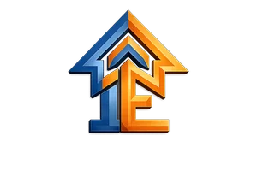
INTEGRITY ENTERPRISE
CORPORATE CAPABILITIES & SIGNAGE PRESENTATION
Global leaders in architectural signage, 3M glass films, precise CNC fabrication, laser cutting, and compliant industrial marking systems engineered for ultimate durability and visual impact.
ISO 9001:2015 CERTIFIED • 3M AUTHORIZED APPLICATOR

Slide 2
ABOUT US
CREDENTIALS & STANDARDS
Integrity Enterprise is a premier manufacturer of architectural signage, 3M glass films, laser cutting, and industrial labeling systems. From our advanced 10,000 sq ft facility, we engineer precision fabrications designed for extreme environmental durability, serving corporate hubs, industrial parks, and global infrastructure projects across 25+ states.
3M AUTHORIZED APPLICATOR
We use premium 3M substrates, architectural glass films, and engineering-grade retroreflective sheets to build high-durability sign systems backed by material guarantees.
10,000 SQ FT FACILITY
Equipped with state-of-the-art high-speed Eco-solvent printers, precision CNC waterjets, V-carve tooling, and laser cutters for micro-metric profile edge quality.
COMPLIANCE MATRIX
Our signages, pipeline indicators, and labeling sheets are built in strict compliance with ISO quality processes and OSHA safety hazard standard specifications.
INTEGRITY ENTERPRISE PRESENTATION
SLIDE 2

Slide 3
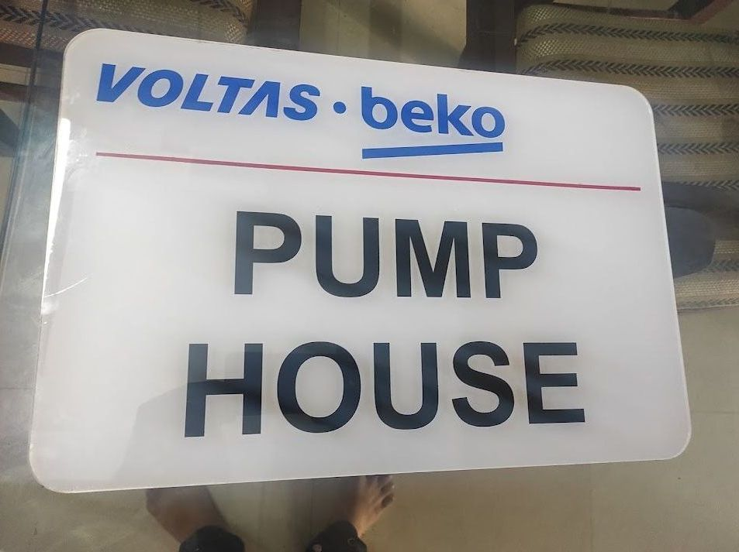
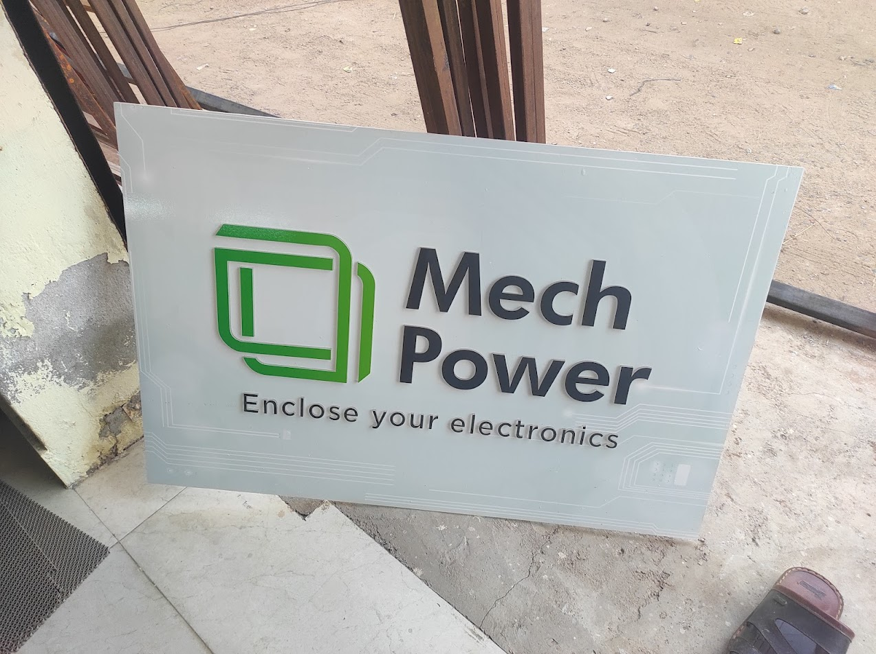
NAME PLATES • ACRYLIC NAME PLATE
ACRYLIC NAME PLATE
Premium Acrylic Name Plate Solutions
PRODUCT OVERVIEW
We design and fabricate premium, custom Acrylic Name Plates engineered for durability, structural integrity, and architectural-grade aesthetics. Ideal for industrial facilities, corporate headquarters, and high-visibility environments.
TECHNICAL SPECIFICATIONS
Material Options: 3M Premium Film, Acrylic, Stainless Steel, Aluminum
Durability: Indoor & Outdoor (UV Resistant)
Compliance: ISO & OSHA Standards
Customization: Fully Customizable Sizes & Graphics
KEY ADVANTAGES
• High-resolution professional grade branding
• Ultra-durable weather and fade-resistant finish
• Precise CNC and laser cutting for seamless edges
INTEGRITY ENTERPRISE PRESENTATION
SLIDE 3

Slide 4
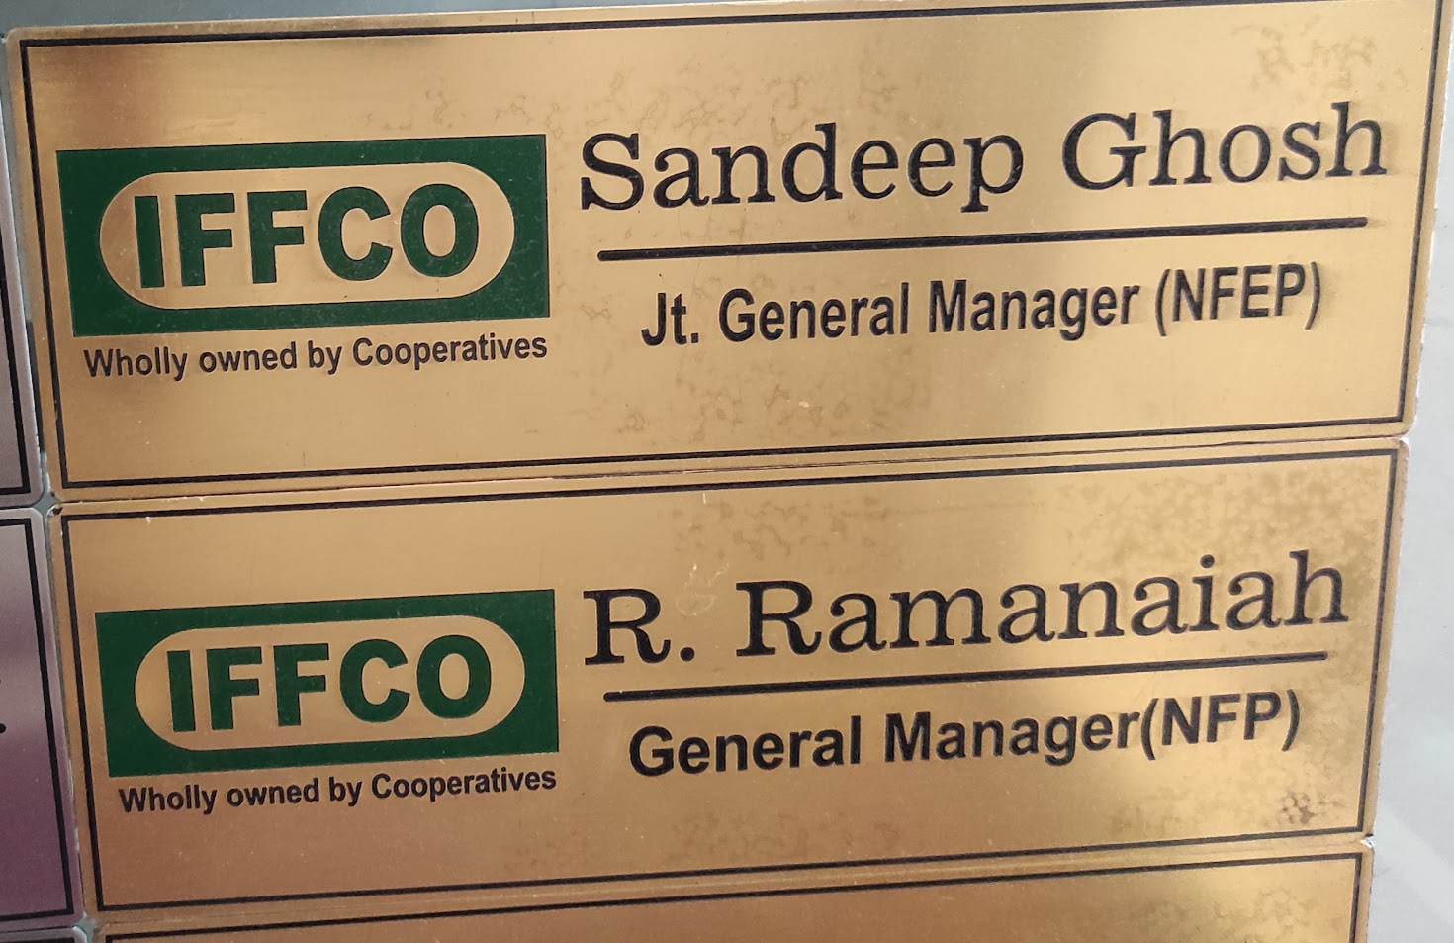
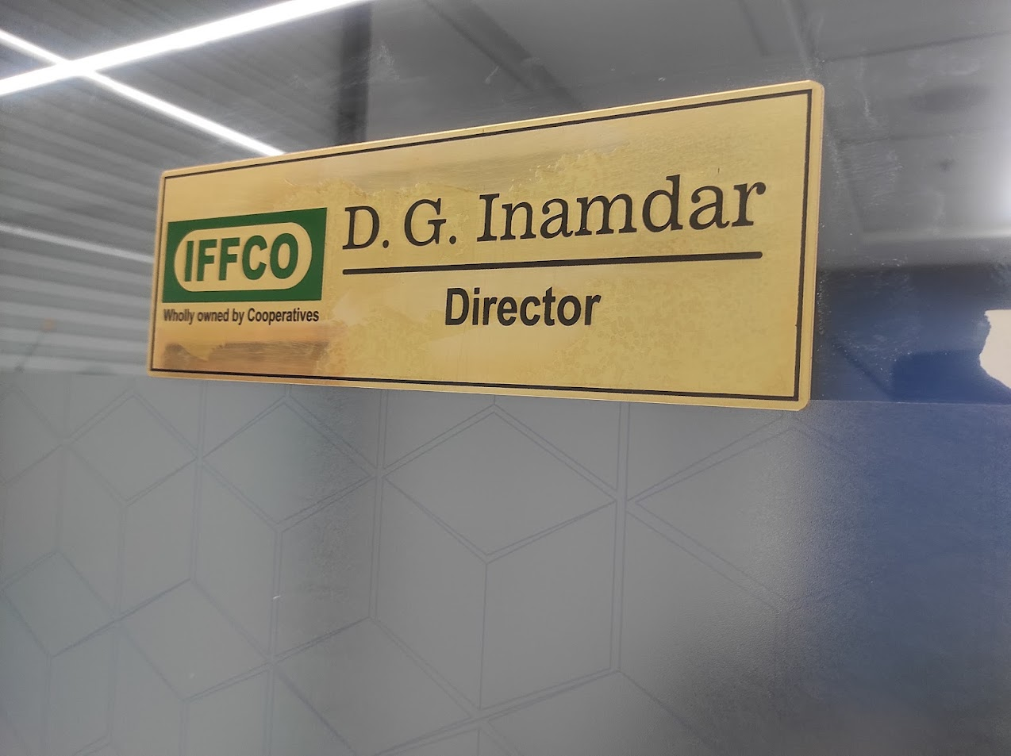
NAME PLATES • BRASS NAME PLATE
BRASS NAME PLATE
Premium Brass Name Plate Solutions
PRODUCT OVERVIEW
We design and fabricate premium, custom Brass Name Plates engineered for durability, structural integrity, and architectural-grade aesthetics. Ideal for industrial facilities, corporate headquarters, and high-visibility environments.
TECHNICAL SPECIFICATIONS
Material Options: 3M Premium Film, Acrylic, Stainless Steel, Aluminum
Durability: Indoor & Outdoor (UV Resistant)
Compliance: ISO & OSHA Standards
Customization: Fully Customizable Sizes & Graphics
KEY ADVANTAGES
• High-resolution professional grade branding
• Ultra-durable weather and fade-resistant finish
• Precise CNC and laser cutting for seamless edges
INTEGRITY ENTERPRISE PRESENTATION
SLIDE 4

Slide 5
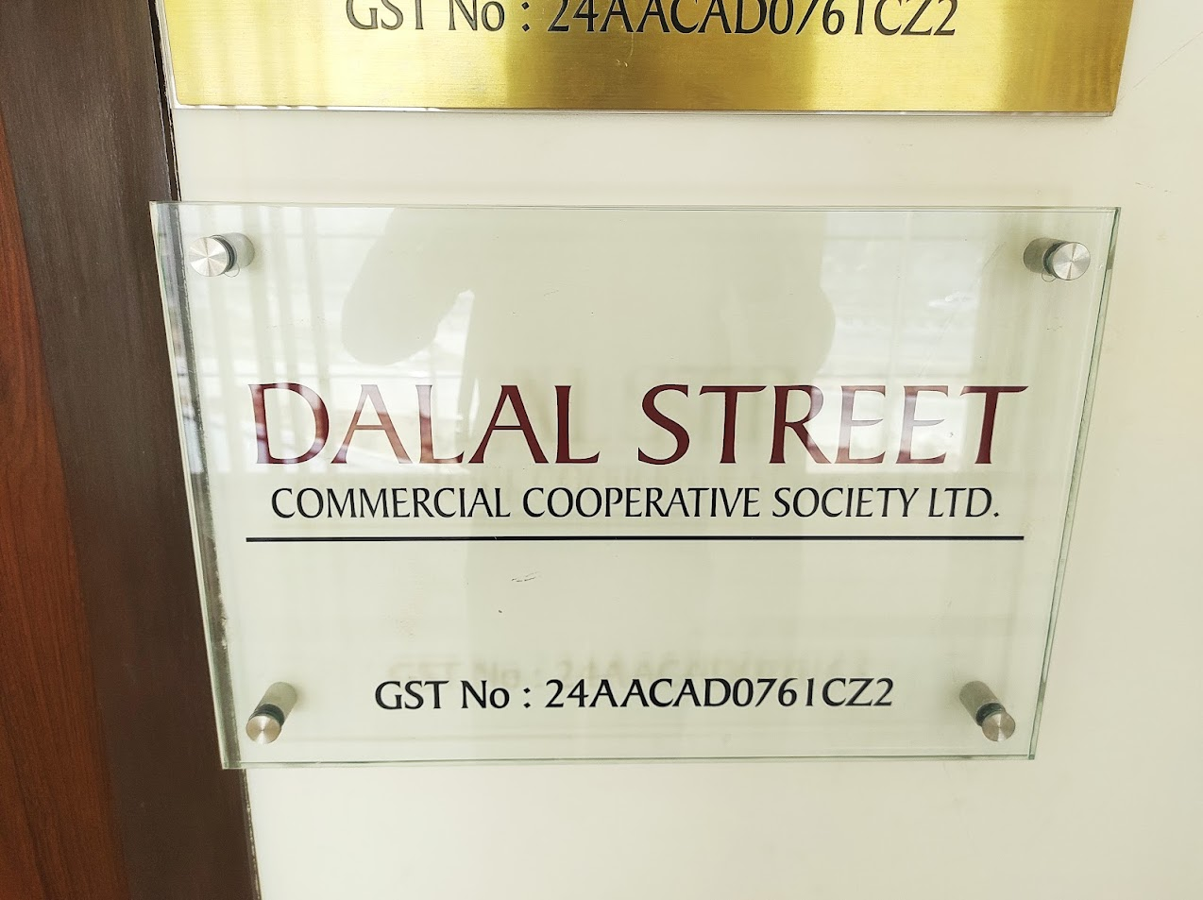
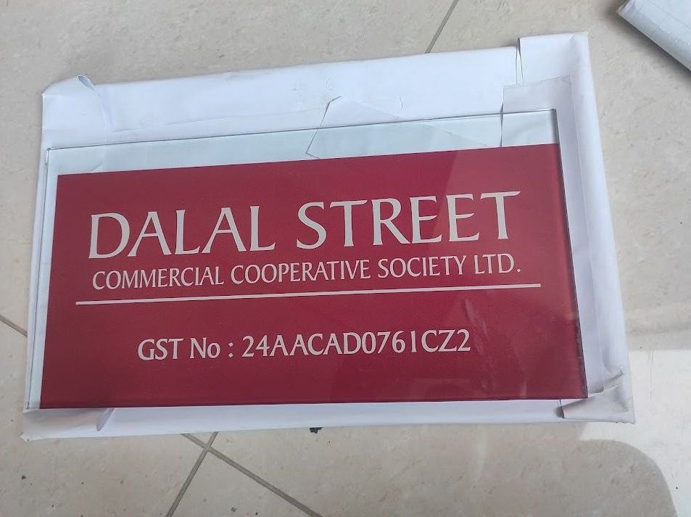
NAME PLATES • GLASS NAME PLATE
GLASS NAME PLATE
Premium Glass Name Plate Solutions
PRODUCT OVERVIEW
We design and fabricate premium, custom Glass Name Plates engineered for durability, structural integrity, and architectural-grade aesthetics. Ideal for industrial facilities, corporate headquarters, and high-visibility environments.
TECHNICAL SPECIFICATIONS
Material Options: 3M Premium Film, Acrylic, Stainless Steel, Aluminum
Durability: Indoor & Outdoor (UV Resistant)
Compliance: ISO & OSHA Standards
Customization: Fully Customizable Sizes & Graphics
KEY ADVANTAGES
• High-resolution professional grade branding
• Ultra-durable weather and fade-resistant finish
• Precise CNC and laser cutting for seamless edges
INTEGRITY ENTERPRISE PRESENTATION
SLIDE 5

Slide 6
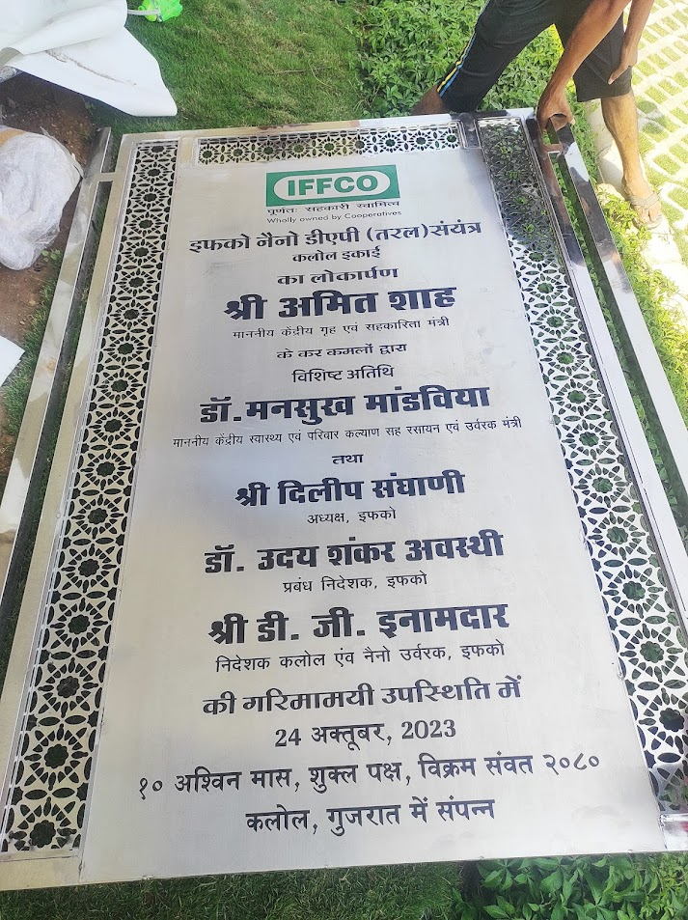
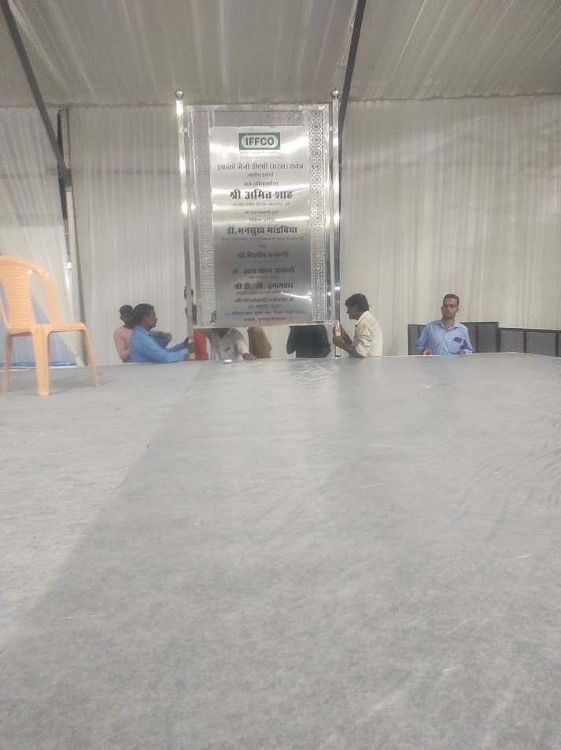
NAME PLATES • INAUGURATION NAME PLATE
INAUGURATION NAME PLATE
Premium Inauguration Name Plate Solutions
PRODUCT OVERVIEW
We design and fabricate premium, custom Inauguration Name Plates engineered for durability, structural integrity, and architectural-grade aesthetics. Ideal for industrial facilities, corporate headquarters, and high-visibility environments.
TECHNICAL SPECIFICATIONS
Material Options: 3M Premium Film, Acrylic, Stainless Steel, Aluminum
Durability: Indoor & Outdoor (UV Resistant)
Compliance: ISO & OSHA Standards
Customization: Fully Customizable Sizes & Graphics
KEY ADVANTAGES
• High-resolution professional grade branding
• Ultra-durable weather and fade-resistant finish
• Precise CNC and laser cutting for seamless edges
INTEGRITY ENTERPRISE PRESENTATION
SLIDE 6

Slide 7
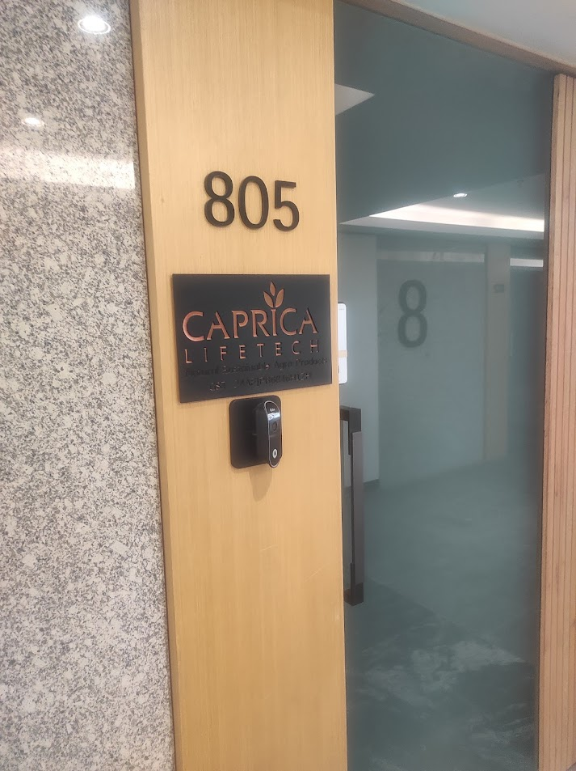
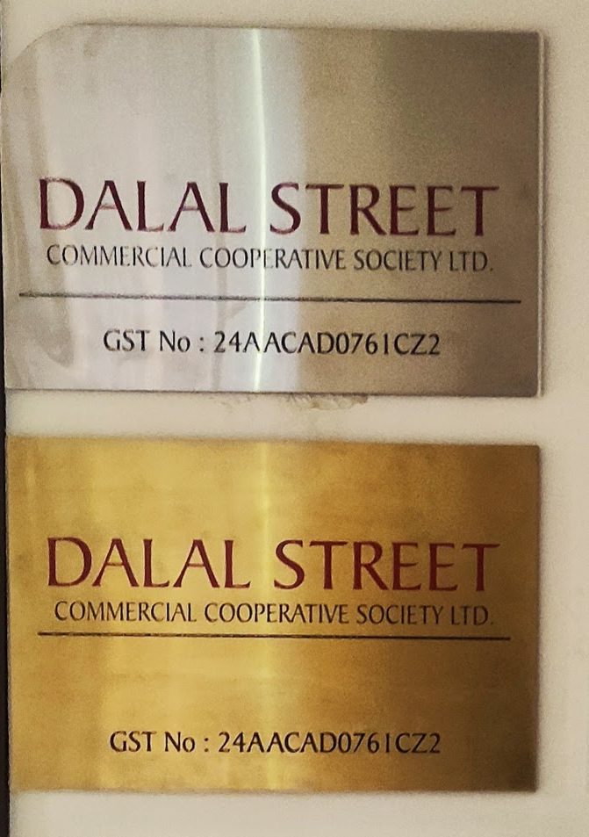
NAME PLATES • METAL NAME PLATE
METAL NAME PLATE
Premium Metal Name Plate Solutions
PRODUCT OVERVIEW
We design and fabricate premium, custom Metal Name Plates engineered for durability, structural integrity, and architectural-grade aesthetics. Ideal for industrial facilities, corporate headquarters, and high-visibility environments.
TECHNICAL SPECIFICATIONS
Material Options: 3M Premium Film, Acrylic, Stainless Steel, Aluminum
Durability: Indoor & Outdoor (UV Resistant)
Compliance: ISO & OSHA Standards
Customization: Fully Customizable Sizes & Graphics
KEY ADVANTAGES
• High-resolution professional grade branding
• Ultra-durable weather and fade-resistant finish
• Precise CNC and laser cutting for seamless edges
INTEGRITY ENTERPRISE PRESENTATION
SLIDE 7

Slide 8
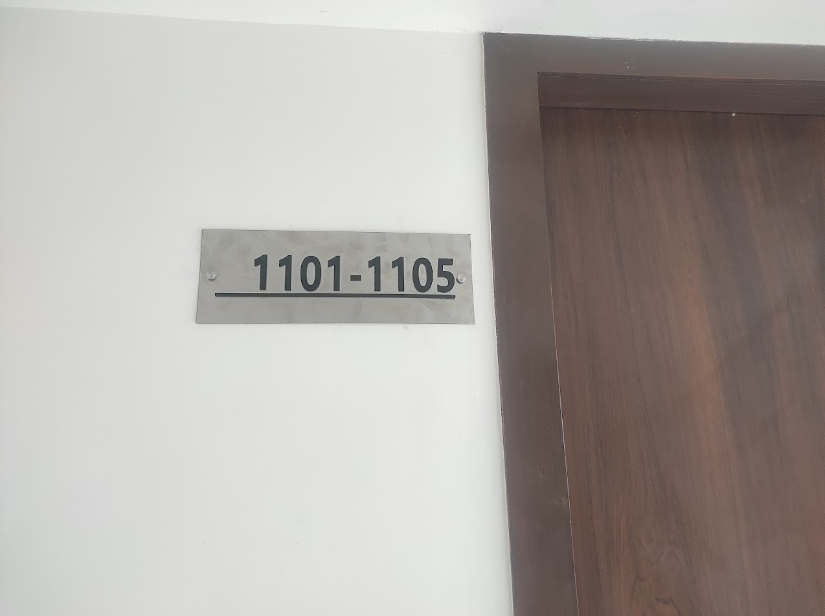
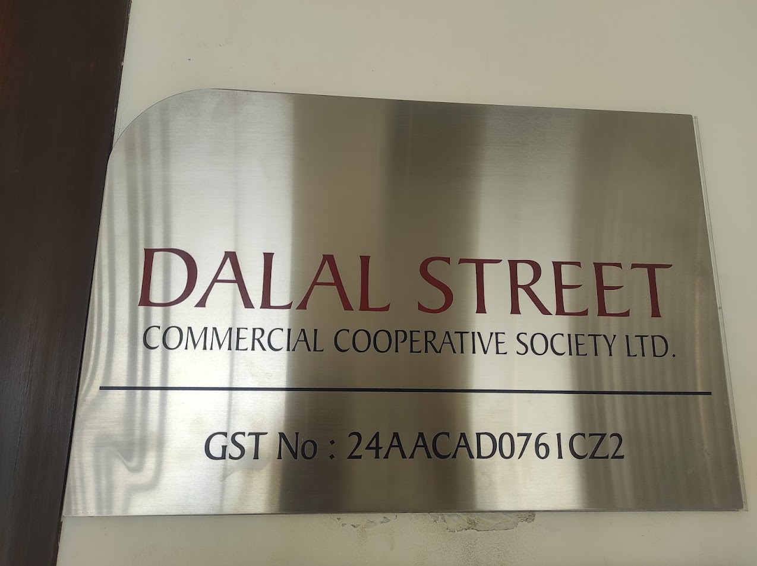
NAME PLATES • SS NAME PLATE
SS NAME PLATE
Premium SS Name Plate Solutions
PRODUCT OVERVIEW
We design and fabricate premium, custom SS Name Plates engineered for durability, structural integrity, and architectural-grade aesthetics. Ideal for industrial facilities, corporate headquarters, and high-visibility environments.
TECHNICAL SPECIFICATIONS
Material Options: 3M Premium Film, Acrylic, Stainless Steel, Aluminum
Durability: Indoor & Outdoor (UV Resistant)
Compliance: ISO & OSHA Standards
Customization: Fully Customizable Sizes & Graphics
KEY ADVANTAGES
• High-resolution professional grade branding
• Ultra-durable weather and fade-resistant finish
• Precise CNC and laser cutting for seamless edges
INTEGRITY ENTERPRISE PRESENTATION
SLIDE 8

Slide 9
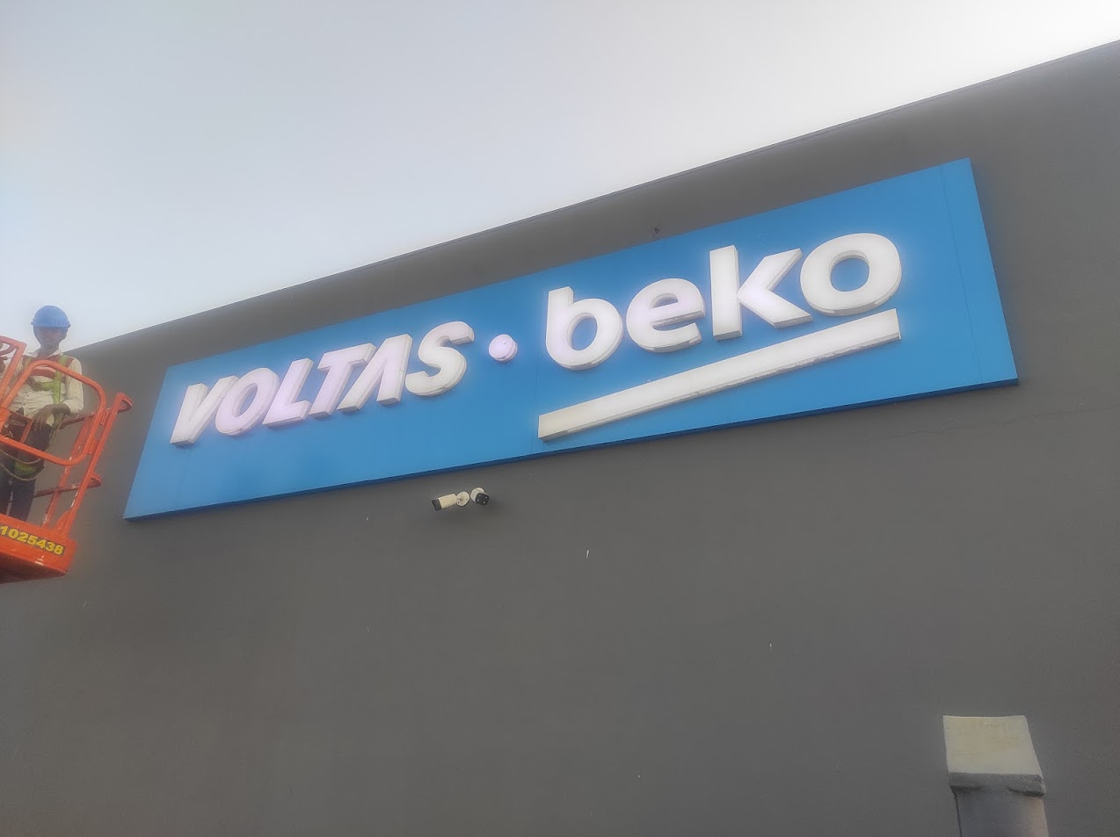
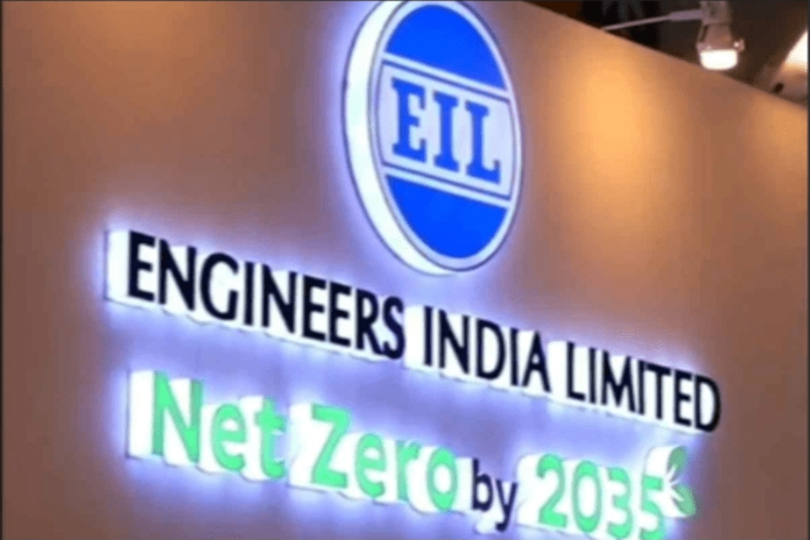
SIGNAGE • ACRYLIC SIGNAGE
ACRYLIC SIGNAGE
Premium Acrylic Signage Solutions
PRODUCT OVERVIEW
We design and fabricate premium, custom Acrylic Signages engineered for durability, structural integrity, and architectural-grade aesthetics. Ideal for industrial facilities, corporate headquarters, and high-visibility environments.
TECHNICAL SPECIFICATIONS
Material Options: 3M Premium Film, Acrylic, Stainless Steel, Aluminum
Durability: Indoor & Outdoor (UV Resistant)
Compliance: ISO & OSHA Standards
Customization: Fully Customizable Sizes & Graphics
KEY ADVANTAGES
• High-resolution professional grade branding
• Ultra-durable weather and fade-resistant finish
• Precise CNC and laser cutting for seamless edges
INTEGRITY ENTERPRISE PRESENTATION
SLIDE 9

Slide 10
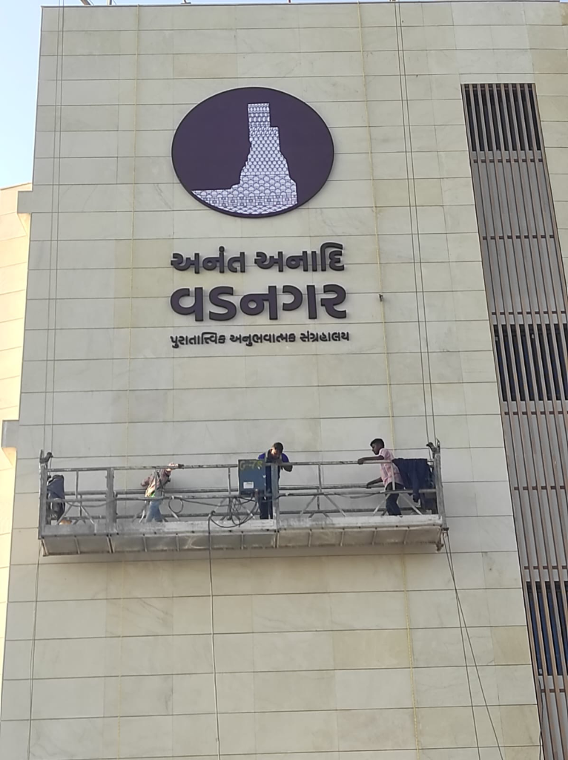
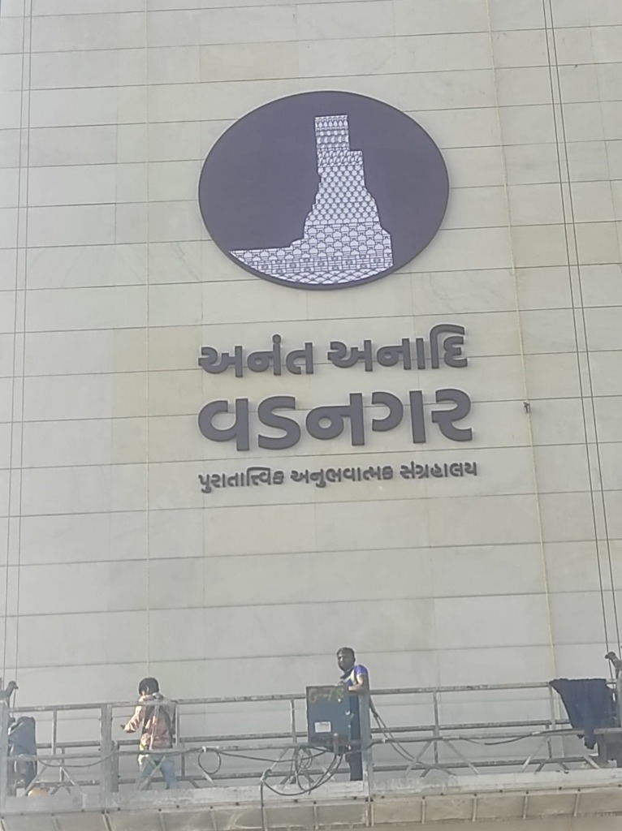
SIGNAGE • EXTERNAL SIGNAGE
EXTERNAL SIGNAGE
Industrial-Grade Outdoor Facade & Identity Signage
PRODUCT OVERVIEW
Our External Signages are heavy-duty, weather-resistant structural systems engineered for corporate buildings, architectural facades, and institutional gateways. Built with anodized aluminum, marine-grade stainless steel, and long-life LED backlighting, they represent the peak of durable outdoor visual branding.
TECHNICAL SPECIFICATIONS
Framing Materials: Anodized Aluminum, 304/316 Stainless Steel, ACP
Lighting Type: Optional Premium IP67 Outdoor LED Modules
Weatherproofing: UV Powder-coated, Anti-rust Treatment
Mounting System: Structural Anchors, Foundation bolts
KEY ADVANTAGES
• Marine-grade stainless steel and structural aluminum framing
• UV-resistant, anti-corrosion protective polyurethane coatings
• Anchored steel base mounting engineered to safety codes
INTEGRITY ENTERPRISE PRESENTATION
SLIDE 10

Slide 11
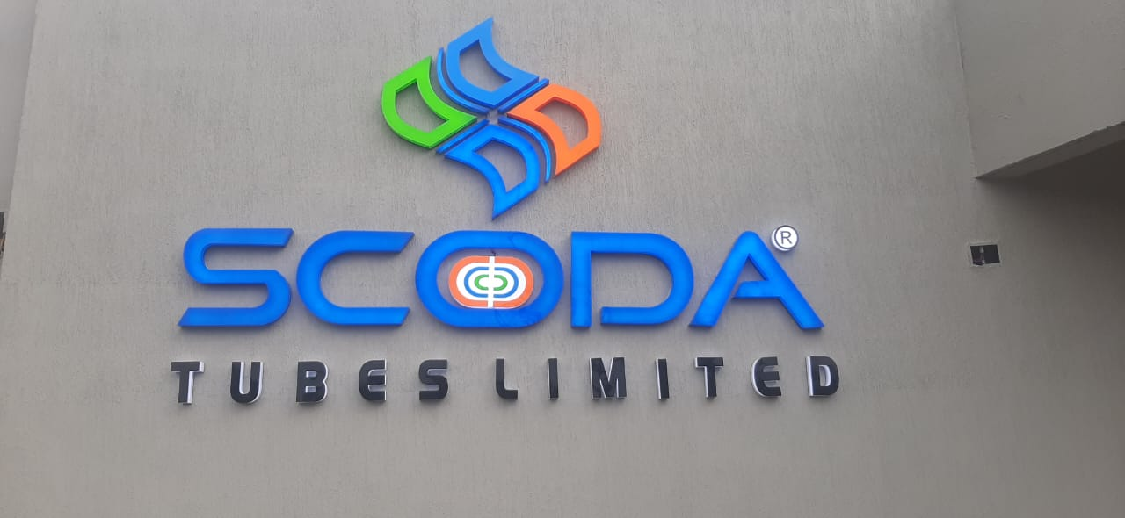
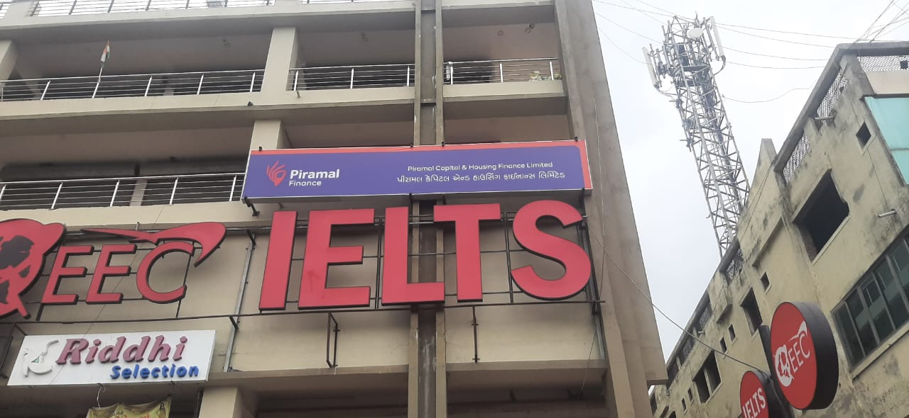
SIGNAGE • FRONTFACE LIT CHANNEL LETTER
FRONTFACE LIT CHANNEL LETTER
Premium FrontFace Lit Channel Letter Solutions
PRODUCT OVERVIEW
We design and fabricate premium, custom FrontFace Lit Channel Letters engineered for durability, structural integrity, and architectural-grade aesthetics. Ideal for industrial facilities, corporate headquarters, and high-visibility environments.
TECHNICAL SPECIFICATIONS
Material Options: 3M Premium Film, Acrylic, Stainless Steel, Aluminum
Durability: Indoor & Outdoor (UV Resistant)
Compliance: ISO & OSHA Standards
Customization: Fully Customizable Sizes & Graphics
KEY ADVANTAGES
• High-resolution professional grade branding
• Ultra-durable weather and fade-resistant finish
• Precise CNC and laser cutting for seamless edges
INTEGRITY ENTERPRISE PRESENTATION
SLIDE 11

Slide 12
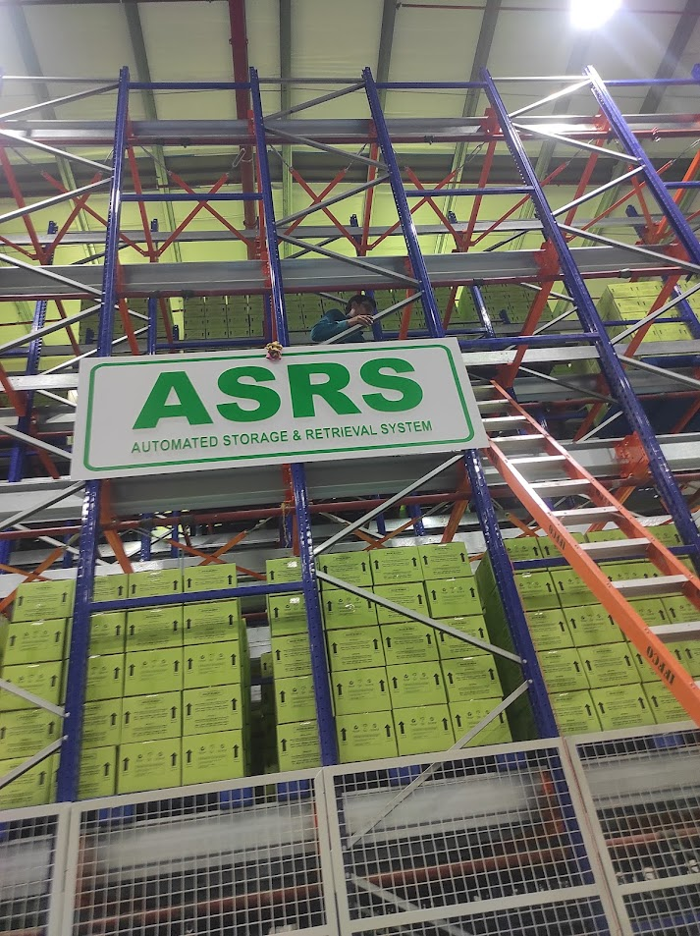
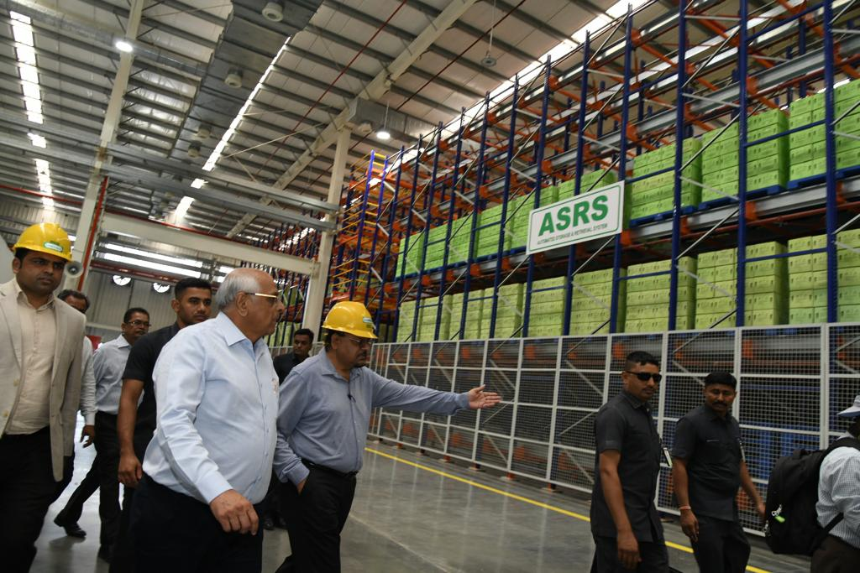
SIGNAGE • INTERNAL SIGNAGE
INTERNAL SIGNAGE
Premium Internal Signage Solutions
PRODUCT OVERVIEW
We design and fabricate premium, custom Internal Signages engineered for durability, structural integrity, and architectural-grade aesthetics. Ideal for industrial facilities, corporate headquarters, and high-visibility environments.
TECHNICAL SPECIFICATIONS
Material Options: 3M Premium Film, Acrylic, Stainless Steel, Aluminum
Durability: Indoor & Outdoor (UV Resistant)
Compliance: ISO & OSHA Standards
Customization: Fully Customizable Sizes & Graphics
KEY ADVANTAGES
• High-resolution professional grade branding
• Ultra-durable weather and fade-resistant finish
• Precise CNC and laser cutting for seamless edges
INTEGRITY ENTERPRISE PRESENTATION
SLIDE 12

Slide 13
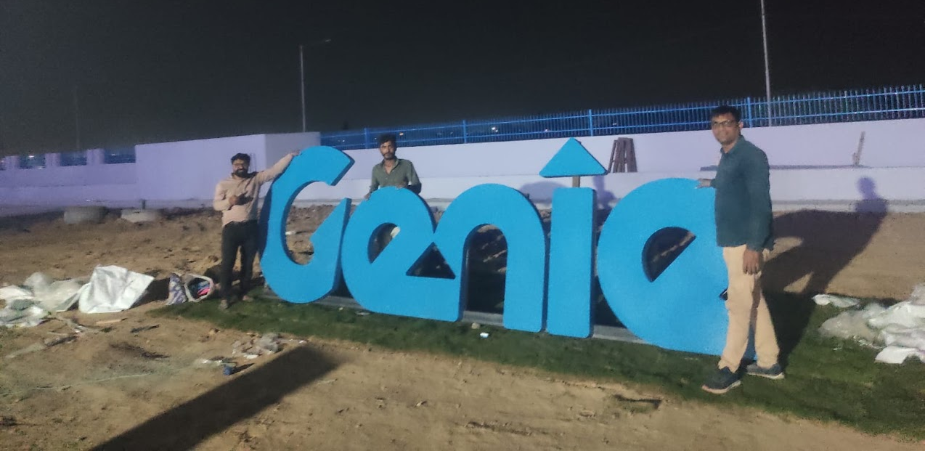
SIGNAGE • LANDSCAPE SIGNAGE
LANDSCAPE SIGNAGE
Premium Landscape Signage Solutions
PRODUCT OVERVIEW
We design and fabricate premium, custom Landscape Signages engineered for durability, structural integrity, and architectural-grade aesthetics. Ideal for industrial facilities, corporate headquarters, and high-visibility environments.
TECHNICAL SPECIFICATIONS
Material Options: 3M Premium Film, Acrylic, Stainless Steel, Aluminum
Durability: Indoor & Outdoor (UV Resistant)
Compliance: ISO & OSHA Standards
Customization: Fully Customizable Sizes & Graphics
KEY ADVANTAGES
• High-resolution professional grade branding
• Ultra-durable weather and fade-resistant finish
• Precise CNC and laser cutting for seamless edges
INTEGRITY ENTERPRISE PRESENTATION
SLIDE 13

Slide 14
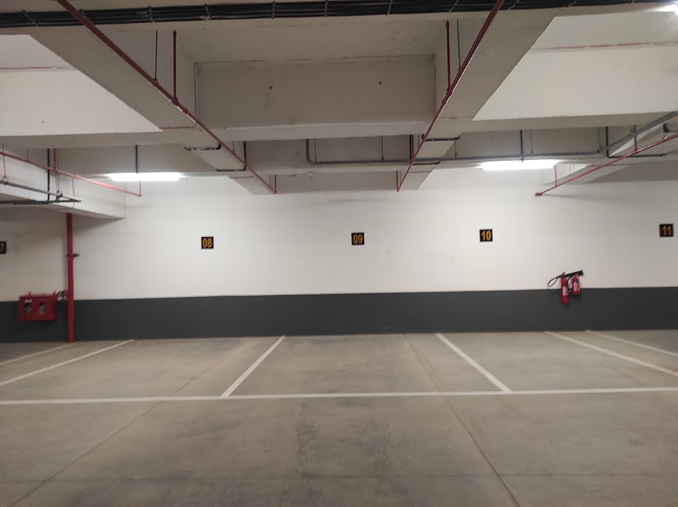
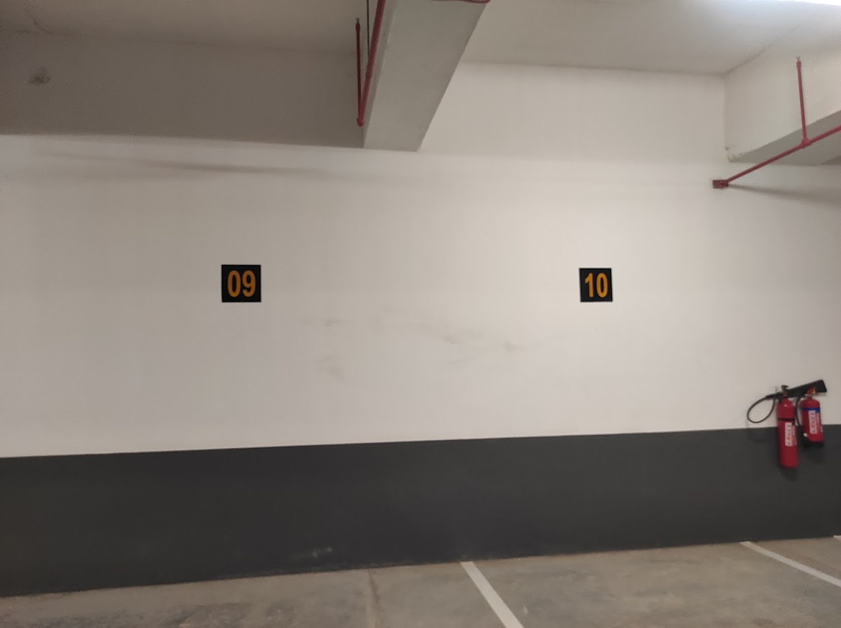
SIGNAGE • PARKING SIGNAGE
PARKING SIGNAGE
Premium Parking Signage Solutions
PRODUCT OVERVIEW
We design and fabricate premium, custom Parking Signages engineered for durability, structural integrity, and architectural-grade aesthetics. Ideal for industrial facilities, corporate headquarters, and high-visibility environments.
TECHNICAL SPECIFICATIONS
Material Options: 3M Premium Film, Acrylic, Stainless Steel, Aluminum
Durability: Indoor & Outdoor (UV Resistant)
Compliance: ISO & OSHA Standards
Customization: Fully Customizable Sizes & Graphics
KEY ADVANTAGES
• High-resolution professional grade branding
• Ultra-durable weather and fade-resistant finish
• Precise CNC and laser cutting for seamless edges
INTEGRITY ENTERPRISE PRESENTATION
SLIDE 14

Slide 15
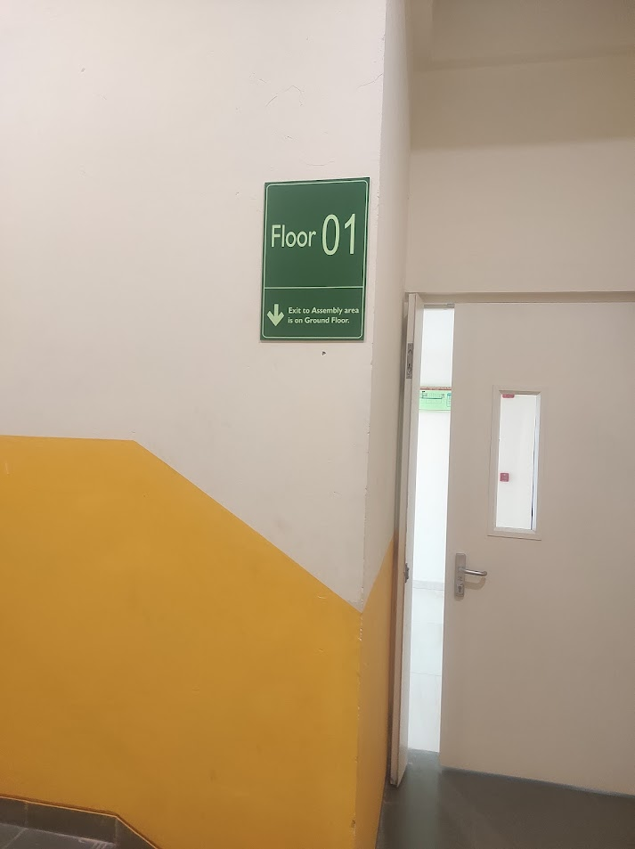
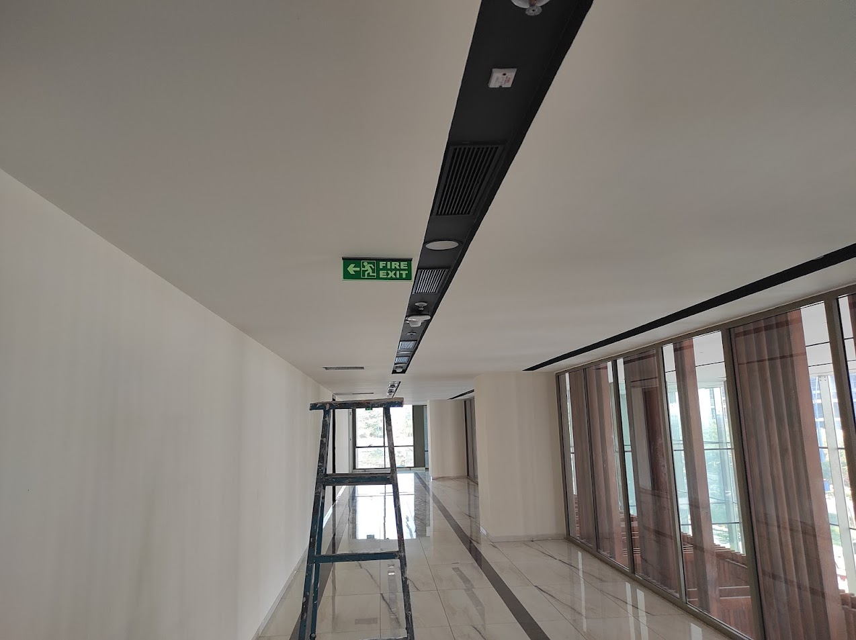
SIGNAGE • SAFETY SIGNAGE
SAFETY SIGNAGE
Premium Safety Signage Solutions
PRODUCT OVERVIEW
We design and fabricate premium, custom Safety Signages engineered for durability, structural integrity, and architectural-grade aesthetics. Ideal for industrial facilities, corporate headquarters, and high-visibility environments.
TECHNICAL SPECIFICATIONS
Material Options: 3M Premium Film, Acrylic, Stainless Steel, Aluminum
Durability: Indoor & Outdoor (UV Resistant)
Compliance: ISO & OSHA Standards
Customization: Fully Customizable Sizes & Graphics
KEY ADVANTAGES
• High-resolution professional grade branding
• Ultra-durable weather and fade-resistant finish
• Precise CNC and laser cutting for seamless edges
INTEGRITY ENTERPRISE PRESENTATION
SLIDE 15

Slide 16
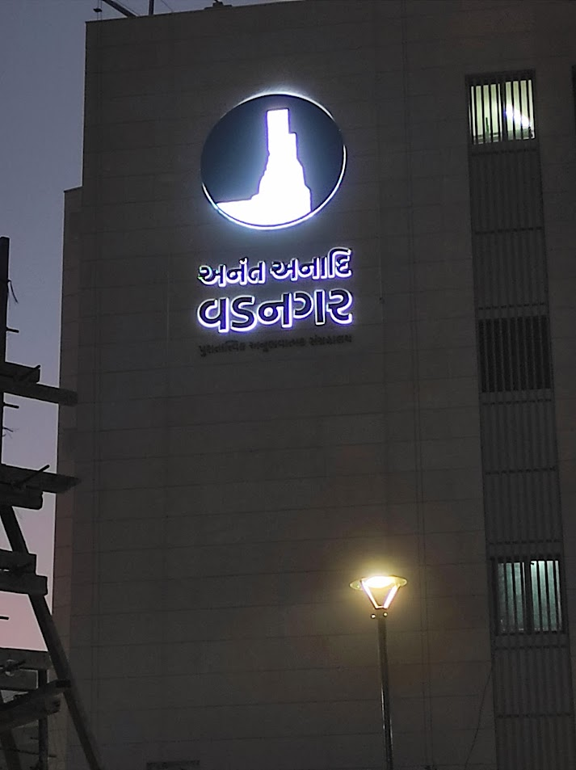
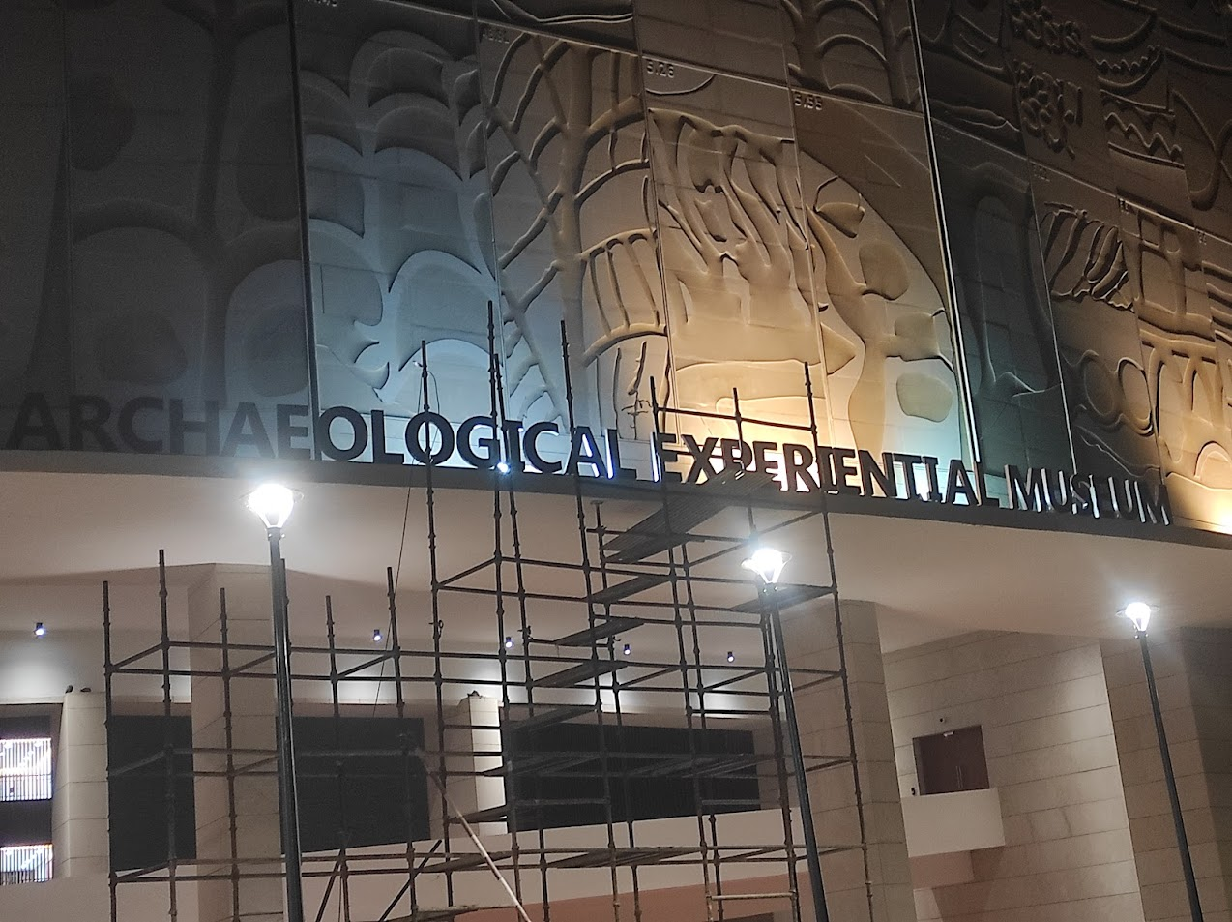
SIGNAGE • STAINLESS STEEL LETTER
STAINLESS STEEL LETTER
Architectural Grade Stainless Steel Letter Signage
PRODUCT OVERVIEW
We fabricate architectural-grade Stainless Steel Letters engineered with precision laser cutting and high-end polishing. Available in premium brushed, mirror-polished, or colored finishes, these signs provide a timeless corporate image with unmatched outdoor weathering resistance.
TECHNICAL SPECIFICATIONS
Material Grade: Premium SS 304 or SS 316 Grade
Finish Options: Brushed Satin, Mirror Polished, Rose Gold, Titanium Gold
Fabrication Method: Precision Fiber Laser Cutting & Argon Welding
Mounting Options: Threaded Stud Mount, Spacer Stand-Offs, Flush Mount
KEY ADVANTAGES
• Marine-grade corrosion and rust resistance
• Precision welded seamless returns for premium 3D depth
• Custom thickness options from 1.2mm to 5mm solid face
INTEGRITY ENTERPRISE PRESENTATION
SLIDE 16

Slide 17
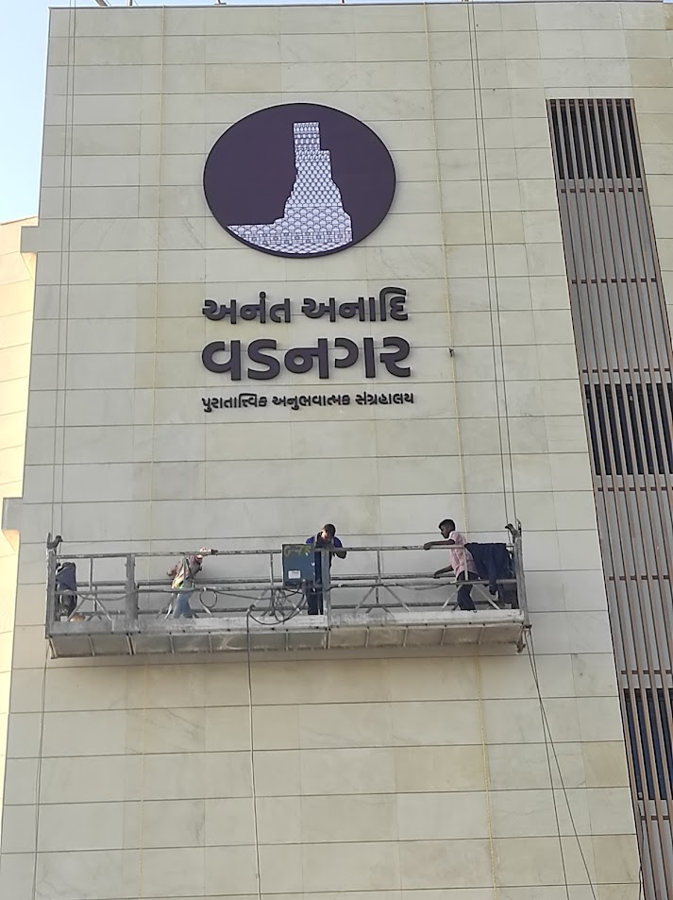
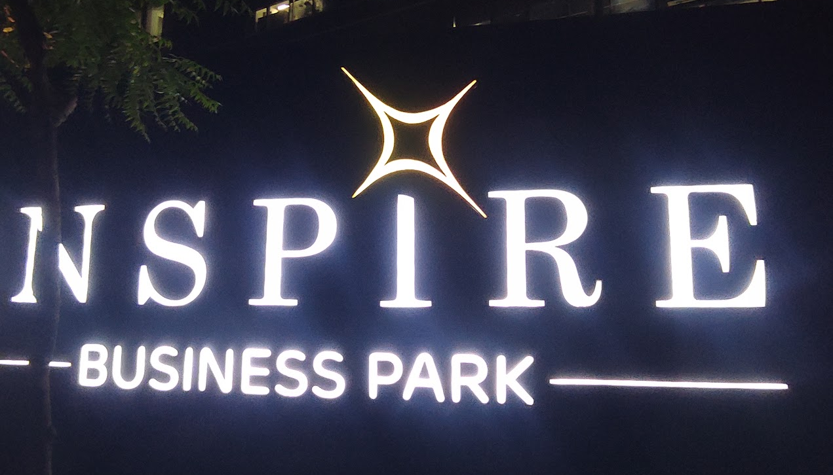
SIGNAGE • STAINLESS STEEL PROFILE LETTER SIGN
STAINLESS STEEL PROFILE LETTER SIGN
Innovative Profile-Cut Stainless Steel Channel Signs
PRODUCT OVERVIEW
Our Stainless Steel Profile Letter Signs combine high-precision structural metal borders with premium acrylic faces or custom integrated illumination. They offer a luxurious 3D dimensional depth and outstanding structural durability, making them a top-tier choice for executive brand identities and landmark signs.
TECHNICAL SPECIFICATIONS
Face Material: High-transmittance Acrylic, Lexan, or Hollow SS Profile
Side Return: Laser-bent Stainless Steel Channel Profiles
Lighting Options: Frontface Lit, Backlit Halo, Dual Illumination, Non-lit
Power Supply: IP67 Outdoor Grade Meanwell Drivers
KEY ADVANTAGES
• Advanced laser return bending for flawless curves and sharp corners
• Energy-efficient high-luminosity waterproof LED modules
• Sleek profile borders with concealed screw attachments
INTEGRITY ENTERPRISE PRESENTATION
SLIDE 17

Slide 18
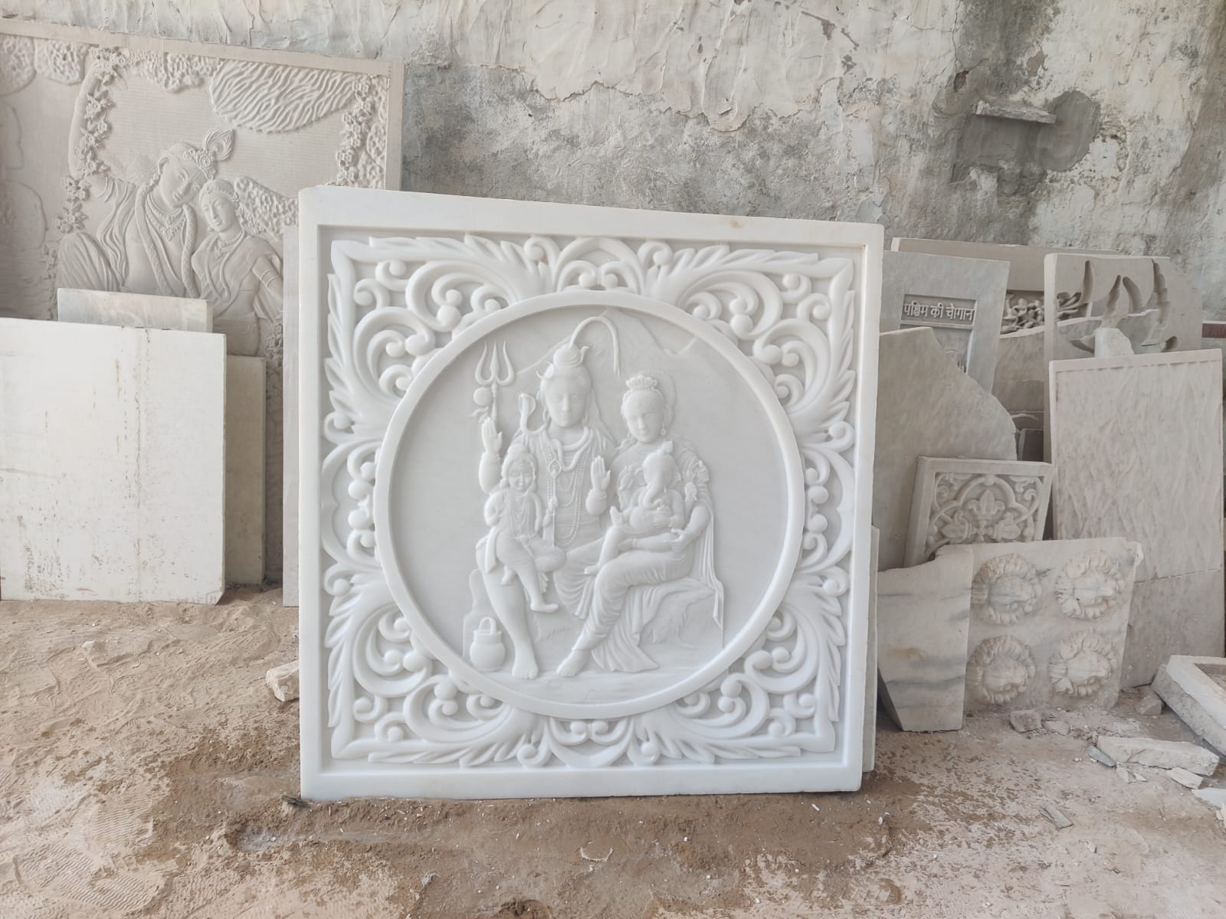
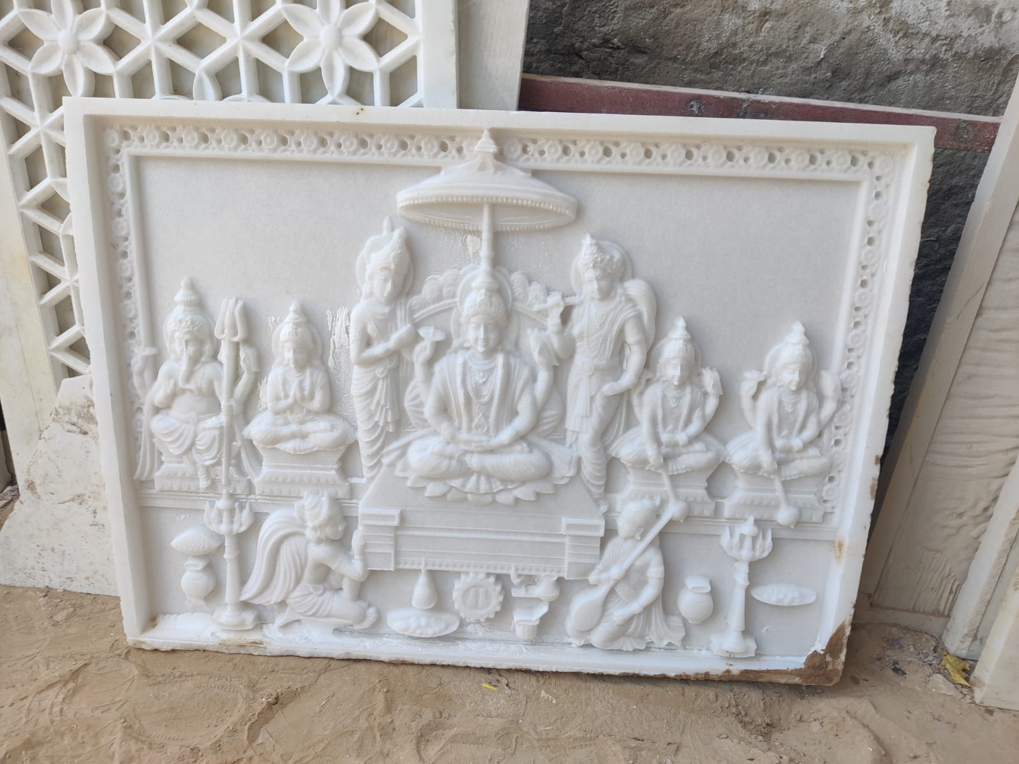
SIGNAGE • STONE ART SIGNAGE
STONE ART SIGNAGE
Artisanal Natural and Engraved Stone Signage
PRODUCT OVERVIEW
Our Stone Art Signages are crafted from premium natural marble, granite, or slate, carved using high-precision CNC engraving or waterjet cutting. These signs combine raw natural beauty with absolute permanence, making them ideal for grand entrance landmarks, institutional plaques, and luxury real estate.
TECHNICAL SPECIFICATIONS
Stone Varieties: Premium Granite, Italian Marble, Slate, Sandstone
Cutting Method: High-Pressure CNC Waterjet & Artisanal V-Carving
Inlay Fill: Weatherproof Epoxies, Gold/Silver Leafing, Liquid Brass
Durability: Absolute Permanent Lifetime Guarantee
KEY ADVANTAGES
• Hand-finished deeply engraved lettering and artwork
• Resistant to extreme thermal expansion and weathering
• Available in rustic natural-edge or high-polished executive borders
INTEGRITY ENTERPRISE PRESENTATION
SLIDE 18

Slide 19
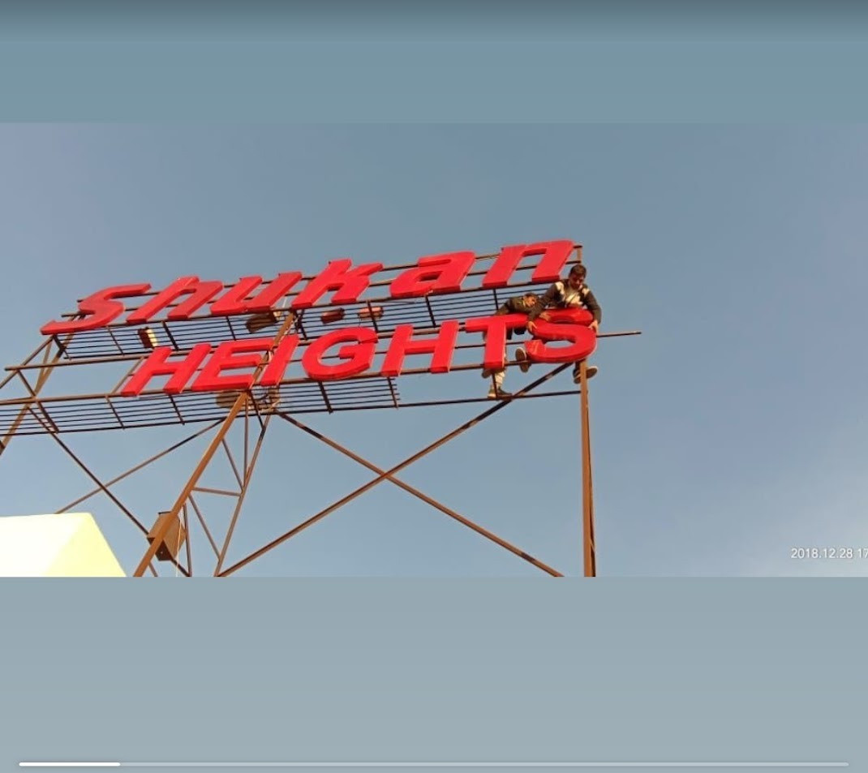
SIGNAGE • TERRACE SIGNAGE
TERRACE SIGNAGE
High-Visibility Rooftop and Skyline Signage
PRODUCT OVERVIEW
Our Terrace Signages are heavy-duty, structural-scale rooftop brandings designed to withstand high-altitude wind loads while delivering maximum skyline visibility. Engineered with structural steel trusses, premium aluminum or SS letter forms, and high-lumen lighting systems, they make your brand stand out for miles.
TECHNICAL SPECIFICATIONS
Structural Support: Heavy Galvanized Steel Wind-Truss System
Wind-Load Compliance: Certified up to 150 km/h wind speeds
Lighting Depth: Ultra-bright double-row LED modules
Shell Metal: Heavy-duty Aluminum or Welded SS 304
KEY ADVANTAGES
• Rigorously engineered structural safety factor calculations
• Automated dusk-to-dawn astronomical timer controls
• Weatherproof anti-rust epoxy structural primer finish
INTEGRITY ENTERPRISE PRESENTATION
SLIDE 19

Slide 20
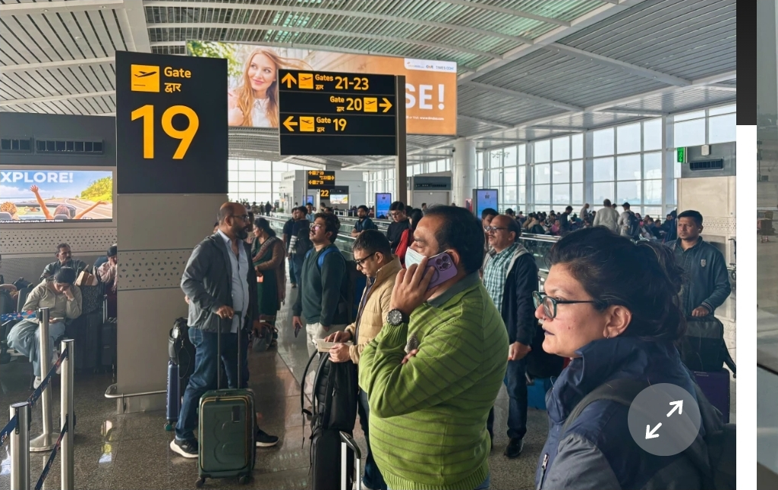
SIGNAGE • WALLPOLE MOUNT SIGNAGE
WALLPOLE MOUNT SIGNAGE
Durable Wall and Pole-Mounted Projecting Signs
PRODUCT OVERVIEW
Our Wallpole Mount Signages are highly functional, dual-sided projecting signs engineered for street-level pedestrian visibility. Mounted on custom decorative steel brackets, these circular, square, or custom-profile lightboxes provide outstanding directional and business identity display.
TECHNICAL SPECIFICATIONS
Mounting Brackets: Wrought Iron, Heavy Steel, or Die-Cast Aluminum
Bracket Type: Projecting Cantilever, Pole Clamped, Flag Mount
Panel Options: Vacuum-Formed Acrylic, ACP, Die-cut Metal
Illumination: Dual-sided Uniform LED backlight
KEY ADVANTAGES
• Dual-sided display for maximum bi-directional visibility
• Reinforced base plates to eliminate bracket sagging
• Weatherproof silicone edge seals to prevent water ingress
INTEGRITY ENTERPRISE PRESENTATION
SLIDE 20

Slide 21
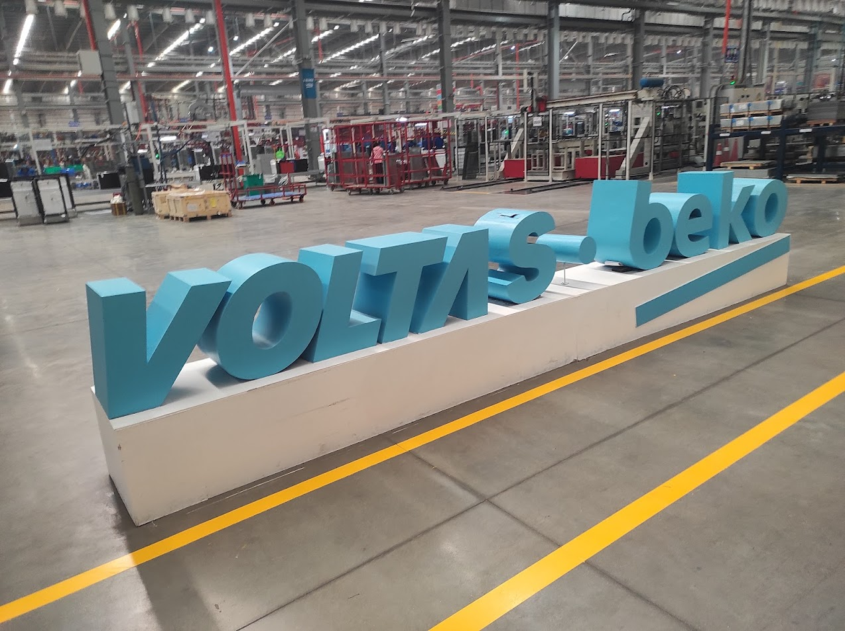
SIGNAGE • WOODEN SIGNAGE
WOODEN SIGNAGE
Premium Carved and Engraved Natural Wood Signs
PRODUCT OVERVIEW
Our Wooden Signages deliver a warm, premium, and organic aesthetic. Precision carved on solid Teak, Sheesham, or Oak using 3D CNC routing and hand-finished with weather-resistant polyurethane coatings, these signs are ideal for wellness spaces, premium resorts, boutiques, and high-end interiors.
TECHNICAL SPECIFICATIONS
Wood Options: Solid Burma Teak, Indian Rosewood (Sheesham), White Oak
Finish Coats: Premium Yacht-grade Polyurethane, Outdoor Oils
Carving Styles: 3D CNC Raised Lettering, V-groove Engraving
Letter Inlays: Liquid Metal, Enamels, Brushed SS, Acrylic
KEY ADVANTAGES
• Kiln-dried seasoned wood to prevent warping and cracking
• Beautiful hand-sanded organic grain texture highlighted
• Advanced UV-shield topcoats to resist sun-bleaching
INTEGRITY ENTERPRISE PRESENTATION
SLIDE 21

Slide 22
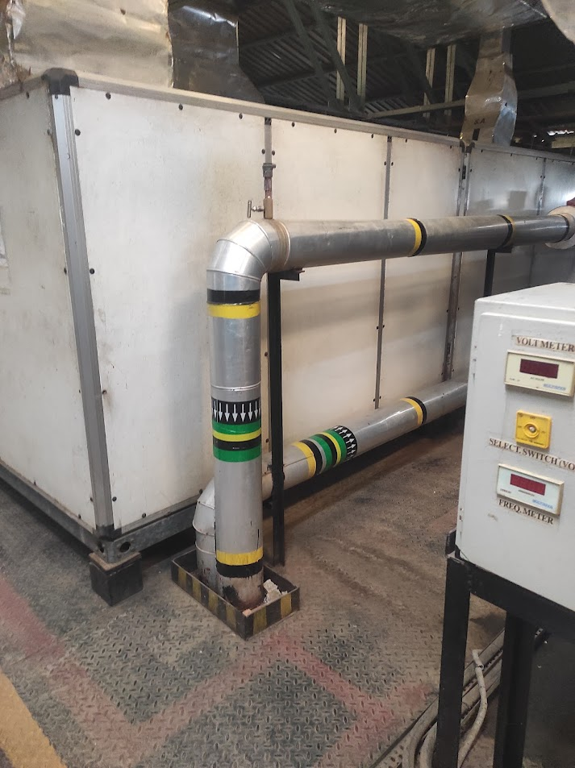
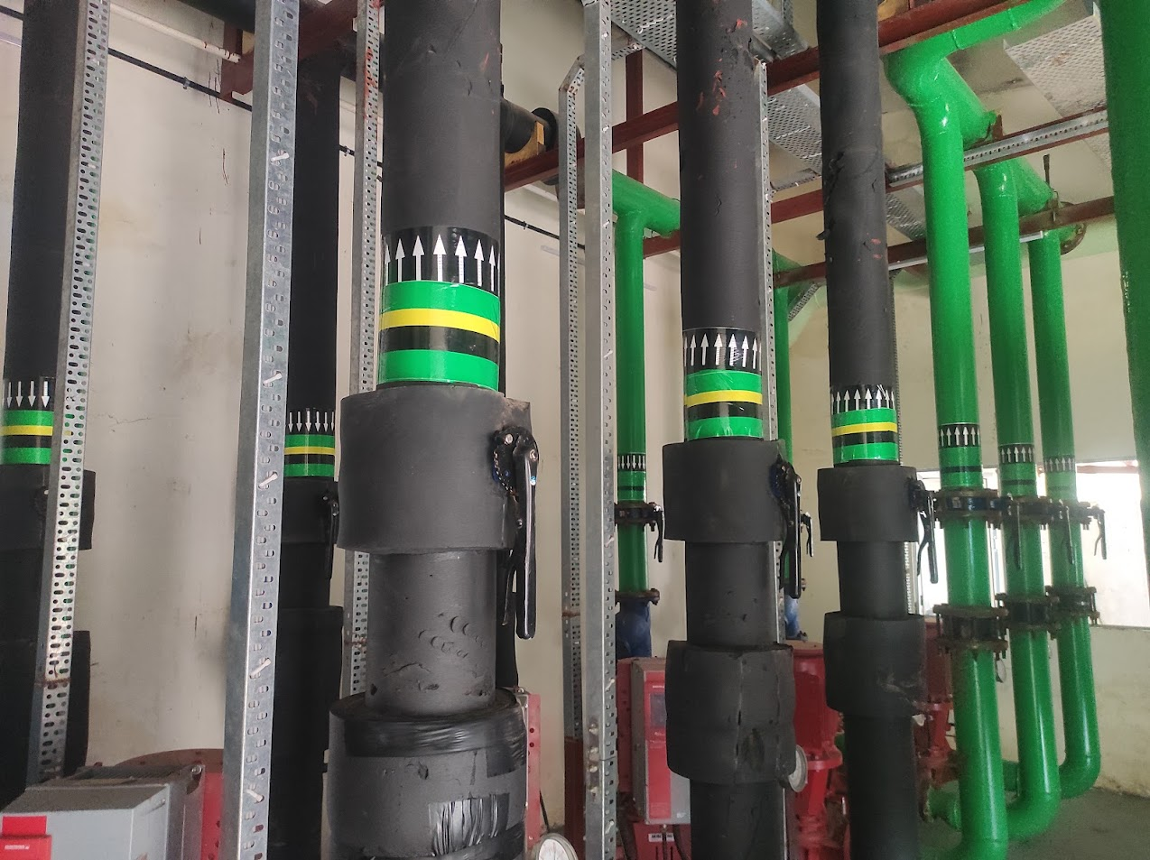
PIPE MARKING • ANSI/ASME A13.1 STANDARD PIPE MARKING
ANSI/ASME A13.1 STANDARD PIPE MARKING
Premium ANSI/ASME A13.1 Standard Pipe Marking Solutions
PRODUCT OVERVIEW
We design and fabricate premium, custom ANSI/ASME A13.1 Standard Pipe Markings engineered for durability, structural integrity, and architectural-grade aesthetics. Ideal for industrial facilities, corporate headquarters, and high-visibility environments.
TECHNICAL SPECIFICATIONS
Material Options: 3M Premium Film, Acrylic, Stainless Steel, Aluminum
Durability: Indoor & Outdoor (UV Resistant)
Compliance: ISO & OSHA Standards
Customization: Fully Customizable Sizes & Graphics
KEY ADVANTAGES
• High-resolution professional grade branding
• Ultra-durable weather and fade-resistant finish
• Precise CNC and laser cutting for seamless edges
INTEGRITY ENTERPRISE PRESENTATION
SLIDE 22

Slide 23
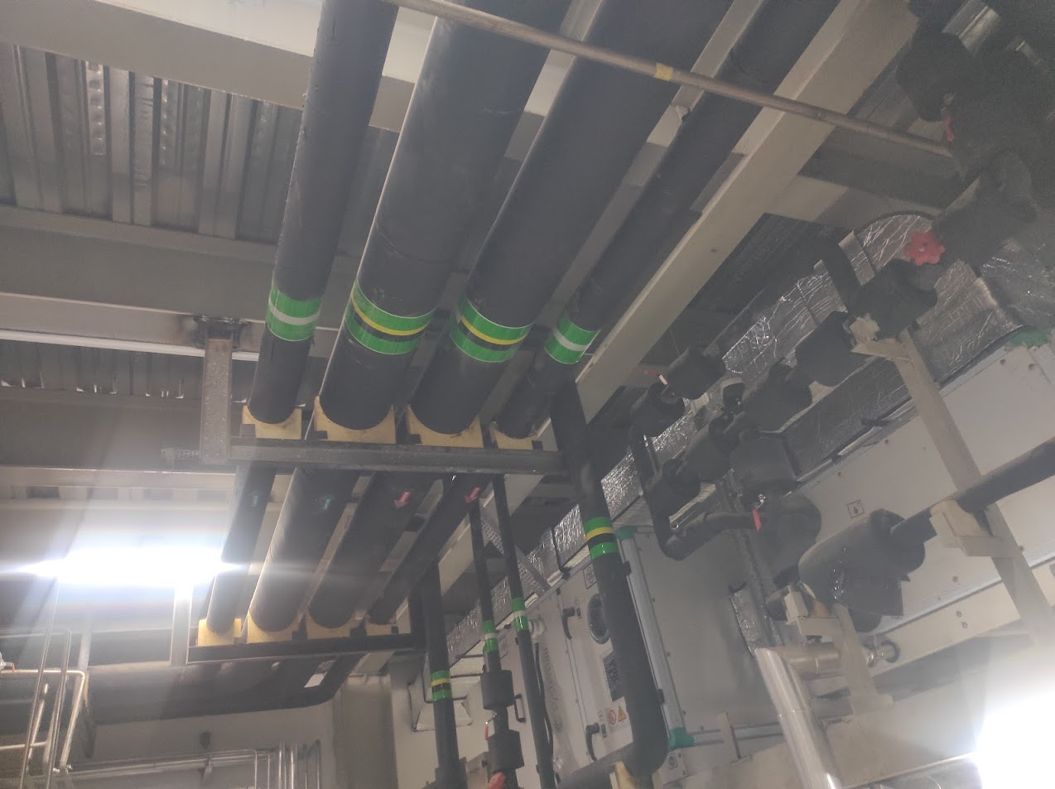
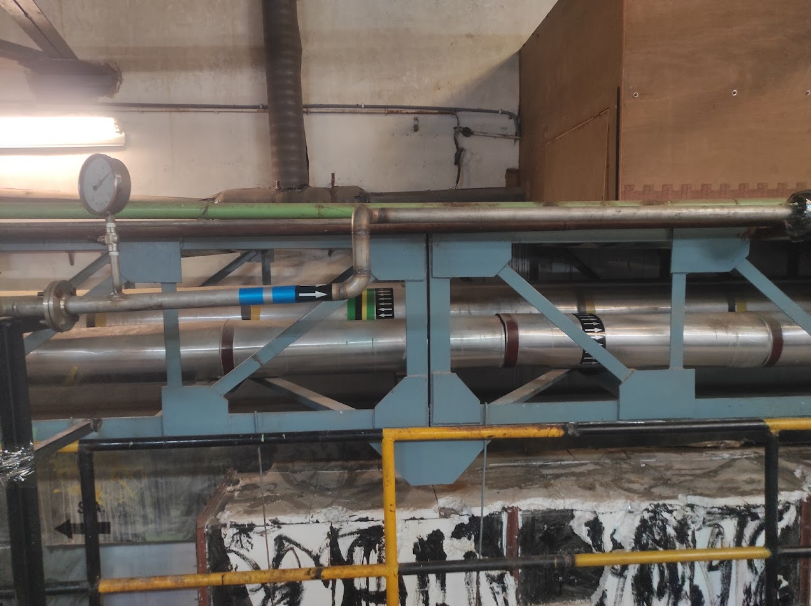
PIPE MARKING • INDUSTRIAL PIPE MARKING
INDUSTRIAL PIPE MARKING
Premium Industrial Pipe Marking Solutions
PRODUCT OVERVIEW
We design and fabricate premium, custom Industrial Pipe Markings engineered for durability, structural integrity, and architectural-grade aesthetics. Ideal for industrial facilities, corporate headquarters, and high-visibility environments.
TECHNICAL SPECIFICATIONS
Material Options: 3M Premium Film, Acrylic, Stainless Steel, Aluminum
Durability: Indoor & Outdoor (UV Resistant)
Compliance: ISO & OSHA Standards
Customization: Fully Customizable Sizes & Graphics
KEY ADVANTAGES
• High-resolution professional grade branding
• Ultra-durable weather and fade-resistant finish
• Precise CNC and laser cutting for seamless edges
INTEGRITY ENTERPRISE PRESENTATION
SLIDE 23

Slide 24
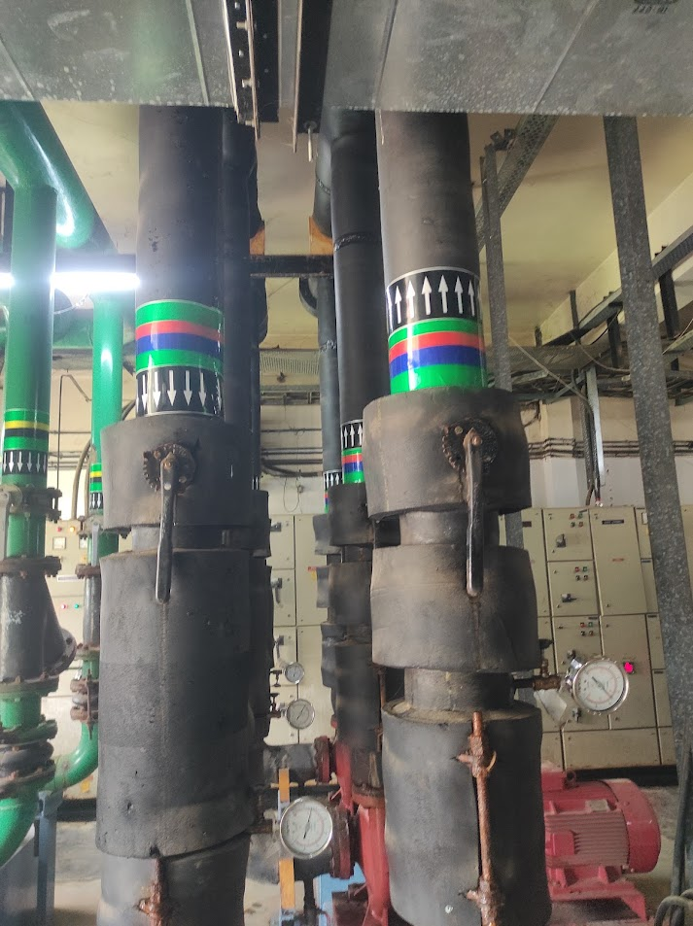
PIPE MARKING • OSHA COMPLIANT PIPE MARKING
OSHA COMPLIANT PIPE MARKING
Premium OSHA Compliant Pipe Marking Solutions
PRODUCT OVERVIEW
We design and fabricate premium, custom OSHA Compliant Pipe Markings engineered for durability, structural integrity, and architectural-grade aesthetics. Ideal for industrial facilities, corporate headquarters, and high-visibility environments.
TECHNICAL SPECIFICATIONS
Material Options: 3M Premium Film, Acrylic, Stainless Steel, Aluminum
Durability: Indoor & Outdoor (UV Resistant)
Compliance: ISO & OSHA Standards
Customization: Fully Customizable Sizes & Graphics
KEY ADVANTAGES
• High-resolution professional grade branding
• Ultra-durable weather and fade-resistant finish
• Precise CNC and laser cutting for seamless edges
INTEGRITY ENTERPRISE PRESENTATION
SLIDE 24

Slide 25
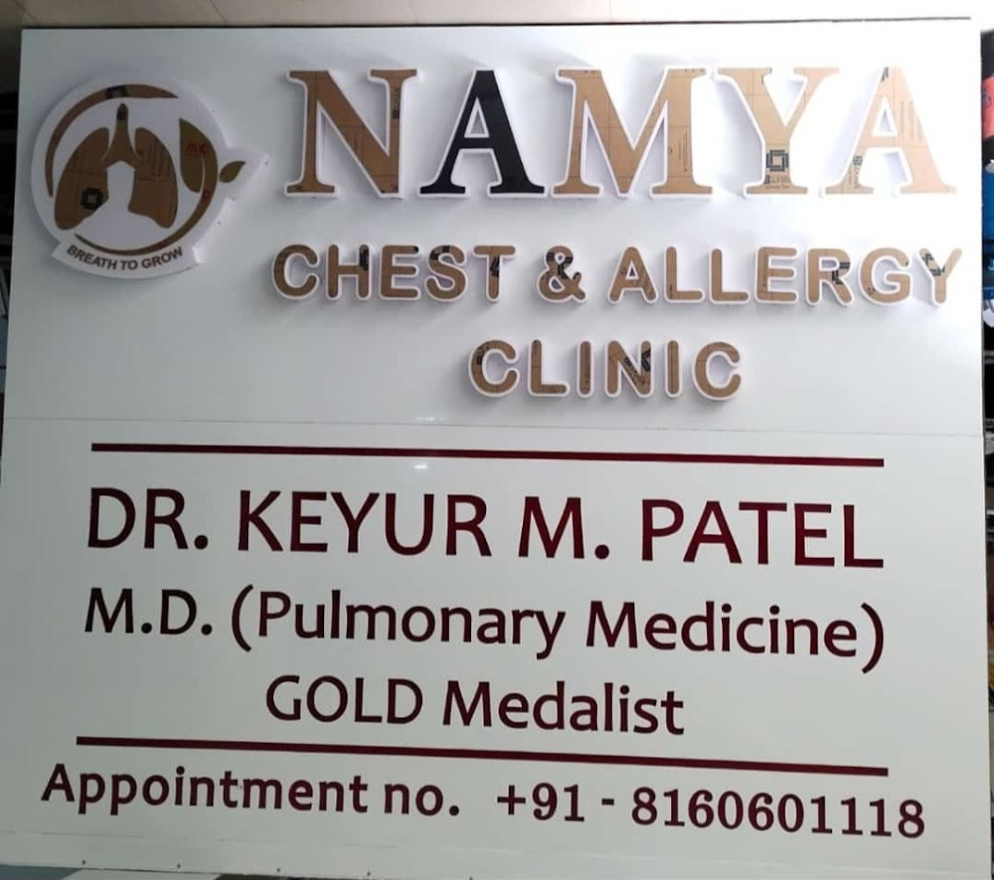
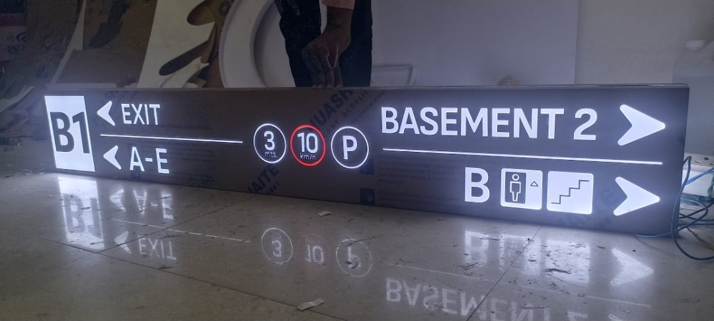
LABELS / FILMS / PANELS • CNC CUT ACP WITH ACRYLIC
CNC CUT ACP WITH ACRYLIC
Premium CNC Cut ACP with Acrylic Solutions
PRODUCT OVERVIEW
We design and fabricate premium, custom CNC Cut ACP with Acrylics engineered for durability, structural integrity, and architectural-grade aesthetics. Ideal for industrial facilities, corporate headquarters, and high-visibility environments.
TECHNICAL SPECIFICATIONS
Material Options: 3M Premium Film, Acrylic, Stainless Steel, Aluminum
Durability: Indoor & Outdoor (UV Resistant)
Compliance: ISO & OSHA Standards
Customization: Fully Customizable Sizes & Graphics
KEY ADVANTAGES
• High-resolution professional grade branding
• Ultra-durable weather and fade-resistant finish
• Precise CNC and laser cutting for seamless edges
INTEGRITY ENTERPRISE PRESENTATION
SLIDE 25

Slide 26
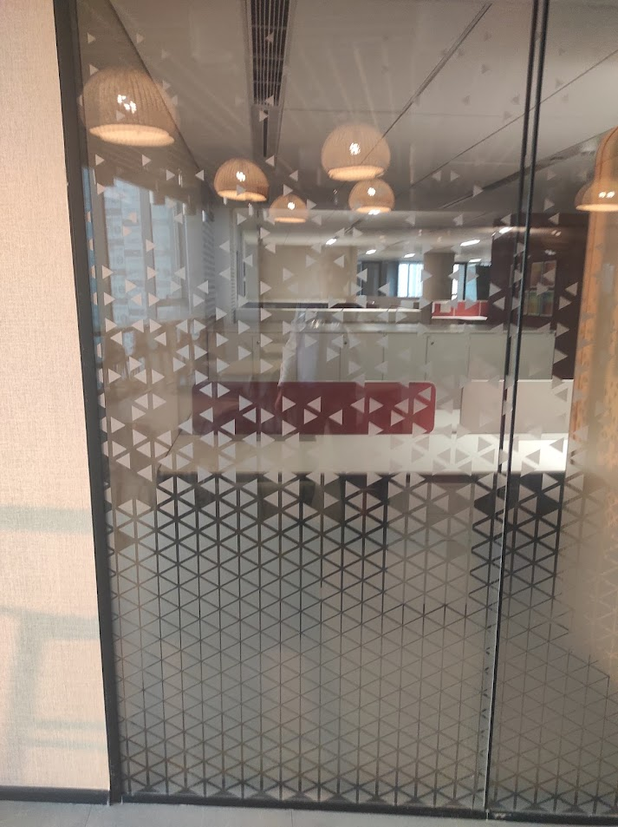
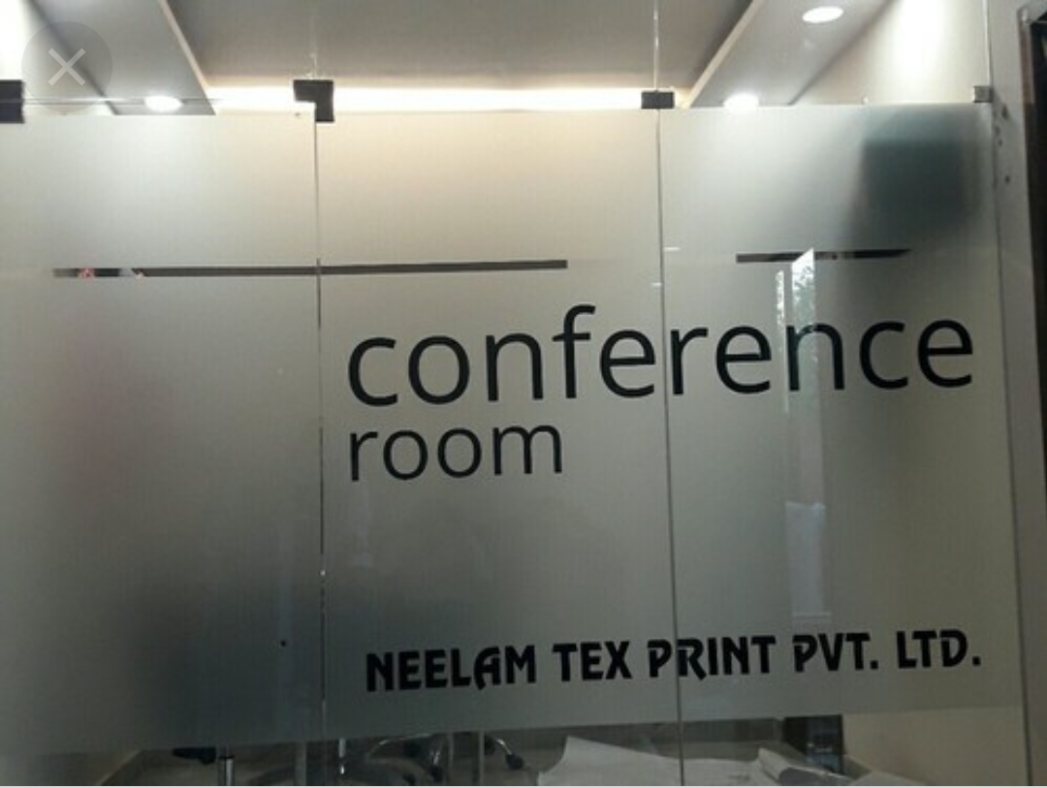
LABELS / FILMS / PANELS • GLASS FILM
GLASS FILM
Premium Glass Film Solutions
PRODUCT OVERVIEW
We design and fabricate premium, custom Glass Films engineered for durability, structural integrity, and architectural-grade aesthetics. Ideal for industrial facilities, corporate headquarters, and high-visibility environments.
TECHNICAL SPECIFICATIONS
Material Options: 3M Premium Film, Acrylic, Stainless Steel, Aluminum
Durability: Indoor & Outdoor (UV Resistant)
Compliance: ISO & OSHA Standards
Customization: Fully Customizable Sizes & Graphics
KEY ADVANTAGES
• High-resolution professional grade branding
• Ultra-durable weather and fade-resistant finish
• Precise CNC and laser cutting for seamless edges
INTEGRITY ENTERPRISE PRESENTATION
SLIDE 26

Slide 27
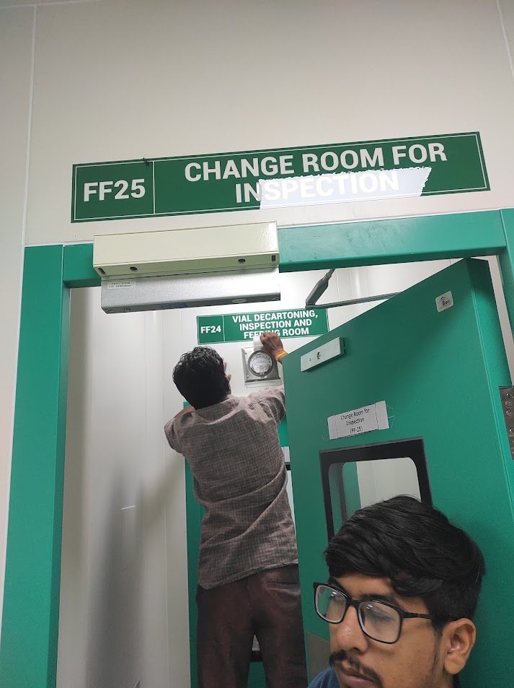
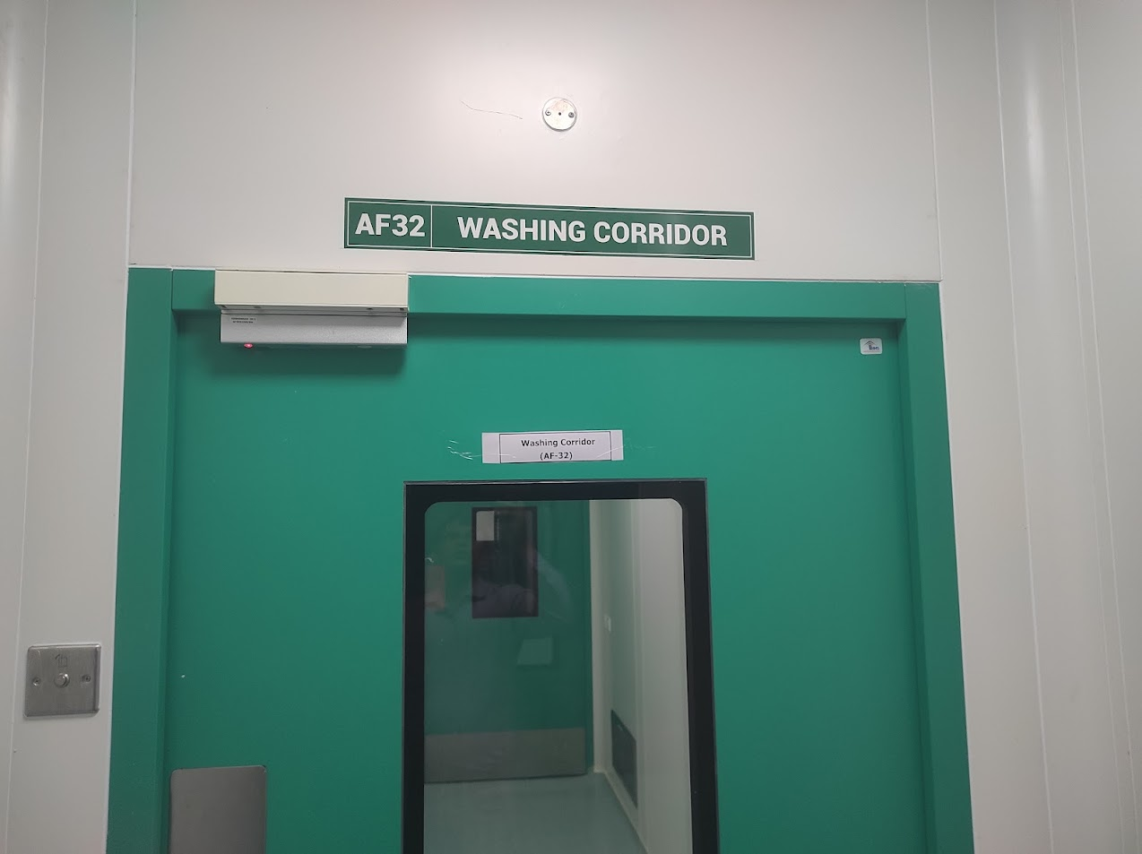
LABELS / FILMS / PANELS • POLYCARBONATE LABEL PC LABEL
POLYCARBONATE LABEL PC LABEL
Premium Polycarbonate Label PC Label Solutions
PRODUCT OVERVIEW
We design and fabricate premium, custom Polycarbonate Label PC Labels engineered for durability, structural integrity, and architectural-grade aesthetics. Ideal for industrial facilities, corporate headquarters, and high-visibility environments.
TECHNICAL SPECIFICATIONS
Material Options: 3M Premium Film, Acrylic, Stainless Steel, Aluminum
Durability: Indoor & Outdoor (UV Resistant)
Compliance: ISO & OSHA Standards
Customization: Fully Customizable Sizes & Graphics
KEY ADVANTAGES
• High-resolution professional grade branding
• Ultra-durable weather and fade-resistant finish
• Precise CNC and laser cutting for seamless edges
INTEGRITY ENTERPRISE PRESENTATION
SLIDE 27

Slide 28
THANK YOU
LET'S BUILD SOMETHING EXCEPTIONAL TOGETHER
INFO@INTEGRITYENTERPRISE.IN • +91 89800 45008 • WWW.INTEGRITYENTERPRISE.IN

